Slide 1
KI Project Workshop @ BBS I Uelzen
LamkI Country with AI – Country with future?
Digital technology as an opportunity for rural areas–
What opportunities does AI offer for the region of Uelzen?

Slide 2

Project: “Country with AI – Country with Future?"
Research Question:
Do artificial intelligence based technologies offer solutions for the deficits perceived by students in the region of Uelzen?
Procedure:
Survey of 193 students at BBS I Uelzen in January 2020 on perceived deficits in the region in various areas of life.
Evaluation of the survey and selection of crucial topics
Conducting two lessons with you
  Thematic introduction: AI + mobility, health, education & work and entertainment offerings
  Workshop: creative, practical work on the subject area
Evaluation of the workshop results and presentation

Slide 3

Central Project Goals
Determination of push and pull factors by means of survey and identification of perceived deficits
Providing basic AI knowledge and current developments in deficient areas of life
Creative development of possible AI-based solutions

Slide 4
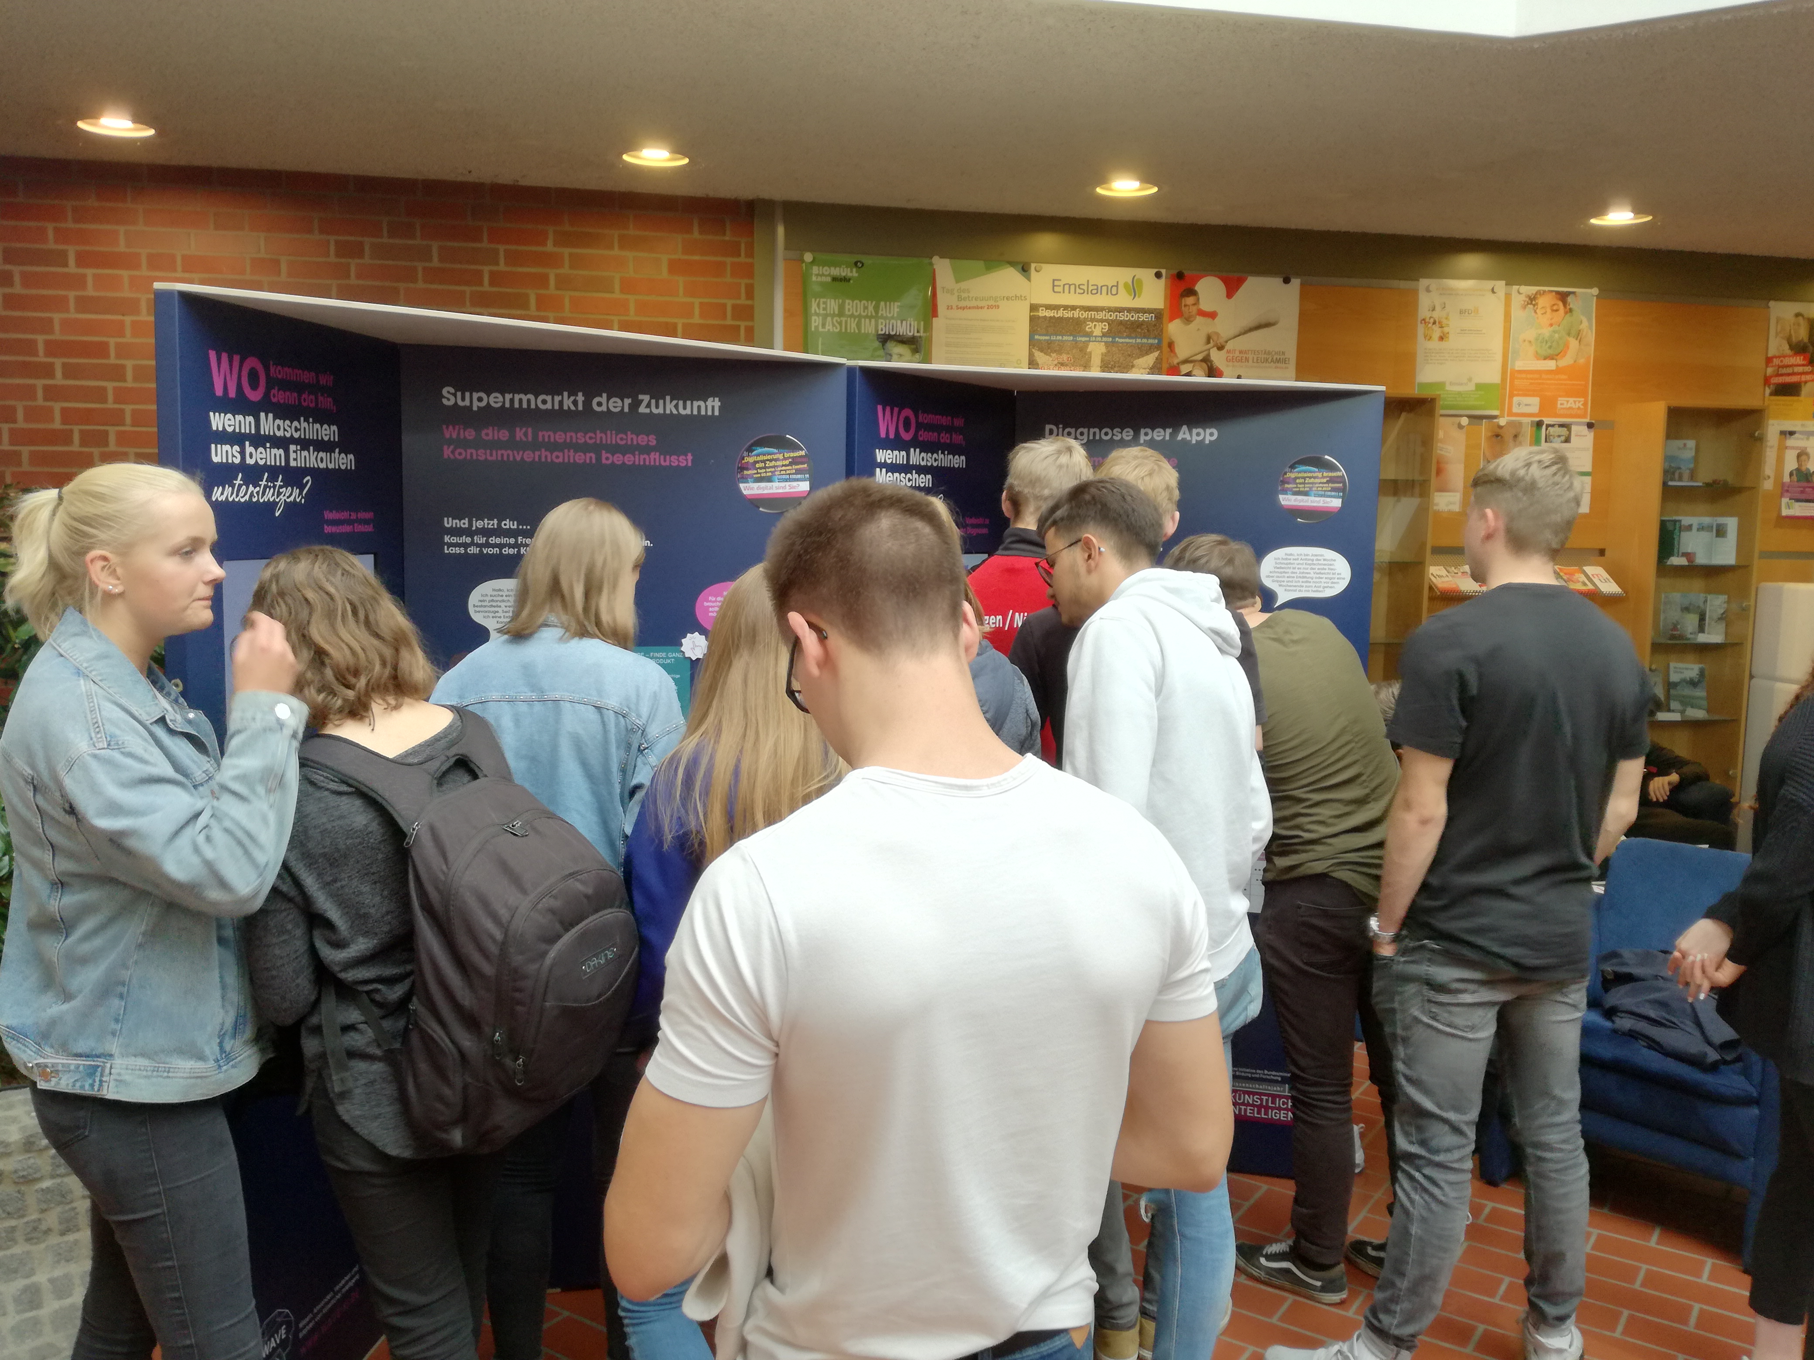
COVID-19: Necessary Adjustments of the Project
Pandemic based uncertainty prevented the "hands-on science" approach and thus using physical AI learning stations
Switch to a virtual format via the Microsoft Teams platform at BBS I Uelzen (2 x 90 minutes)
Integration of interactive participation tool as well as entertaining AI applications to compensate for the omission of physical interaction
Unchanged project goals
Notes:
https://www.wave-ki.de/

Slide 5
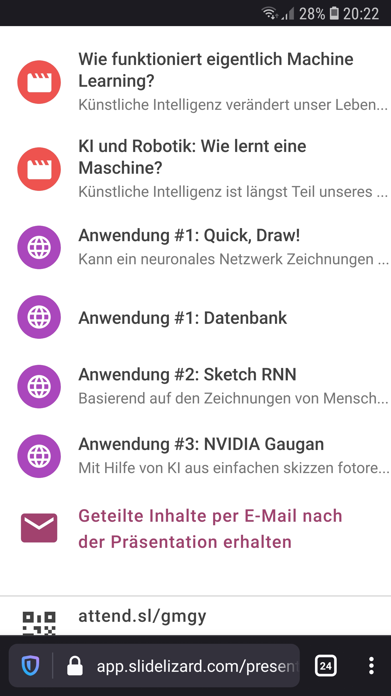
Interactive Tool: SlideLizard
Participation opportunity for students during presentations via smartphones, tablets or computers
  Participation through votings and quizzes
  Asking questions during the presentation
  Linking to articles, videos, and interactive applications
  Collecting anonymous feedback
Notes:
https://slidelizard.com/de

Slide 6

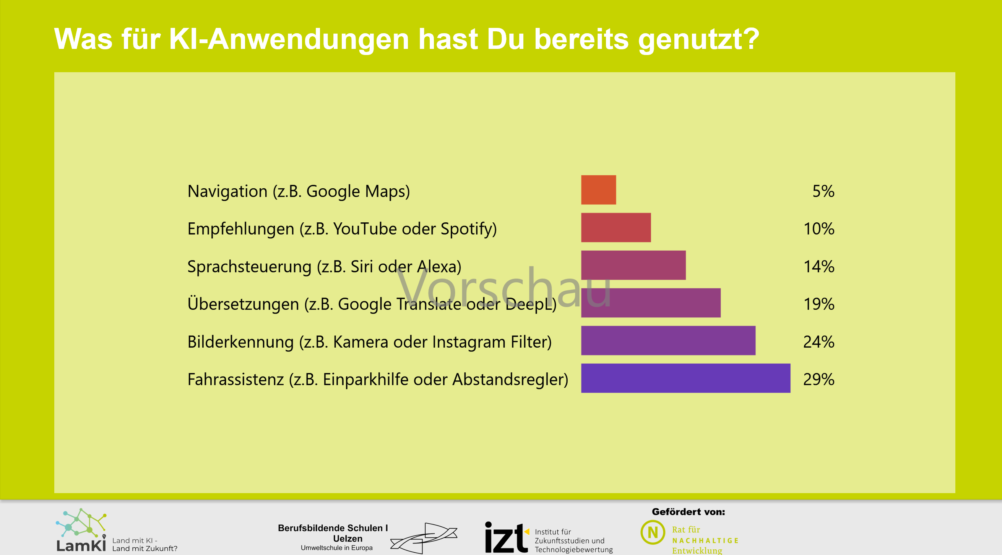
Sample Question: SlideLizard

Slide 7
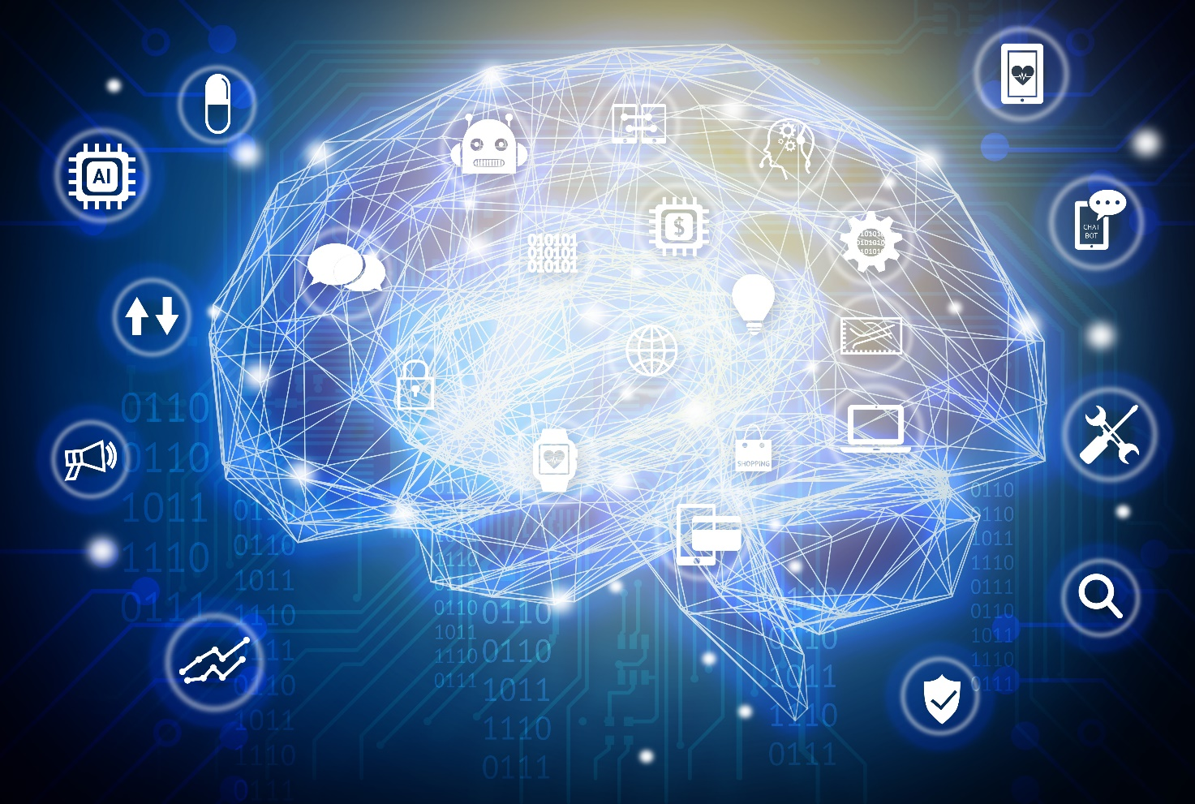
Introduction Artificial Intelligence (AI)
What actually is Artificial Intelligence?
How has the understanding of AI changed over the course
of time?
What are the “three pillars of AI"?
What are the challenges in dealing with AI?

Slide 8

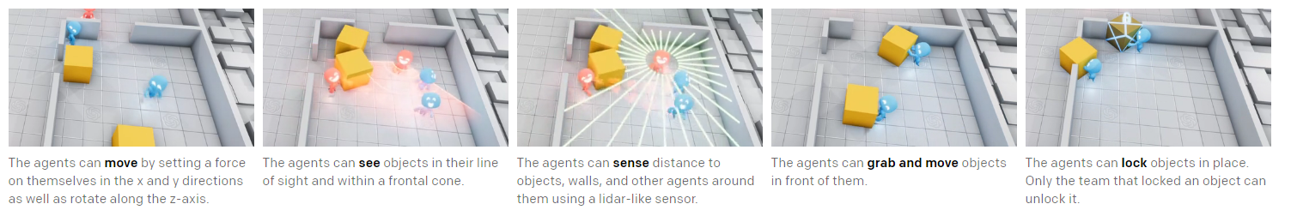
How today's AI learn
Example: Hide & Seek
Notes:
https://openai.com/blog/emergent-tool-use/

Slide 9
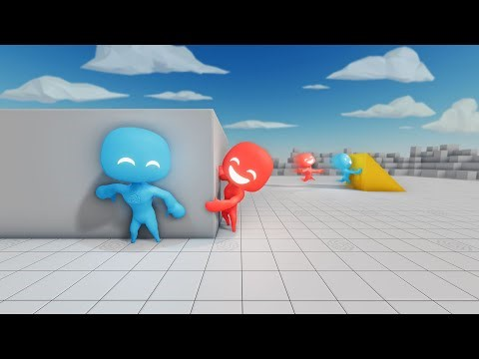
How today's AI learn
Example: Hide & Seek
Notes:
https://www.youtube.com/watch?v=kopoLzvh5jY

Slide 10

Feedback
How did you like the AI and Health learning unit overall? Please use the scale from 1 to 5 stars for your rating.
Please use the text box to give us feedback:
Was the content understandable for you?
Were there parts that seemed too long?
What would you have liked to have more information about?
How did you like the online format overall?

Slide 11
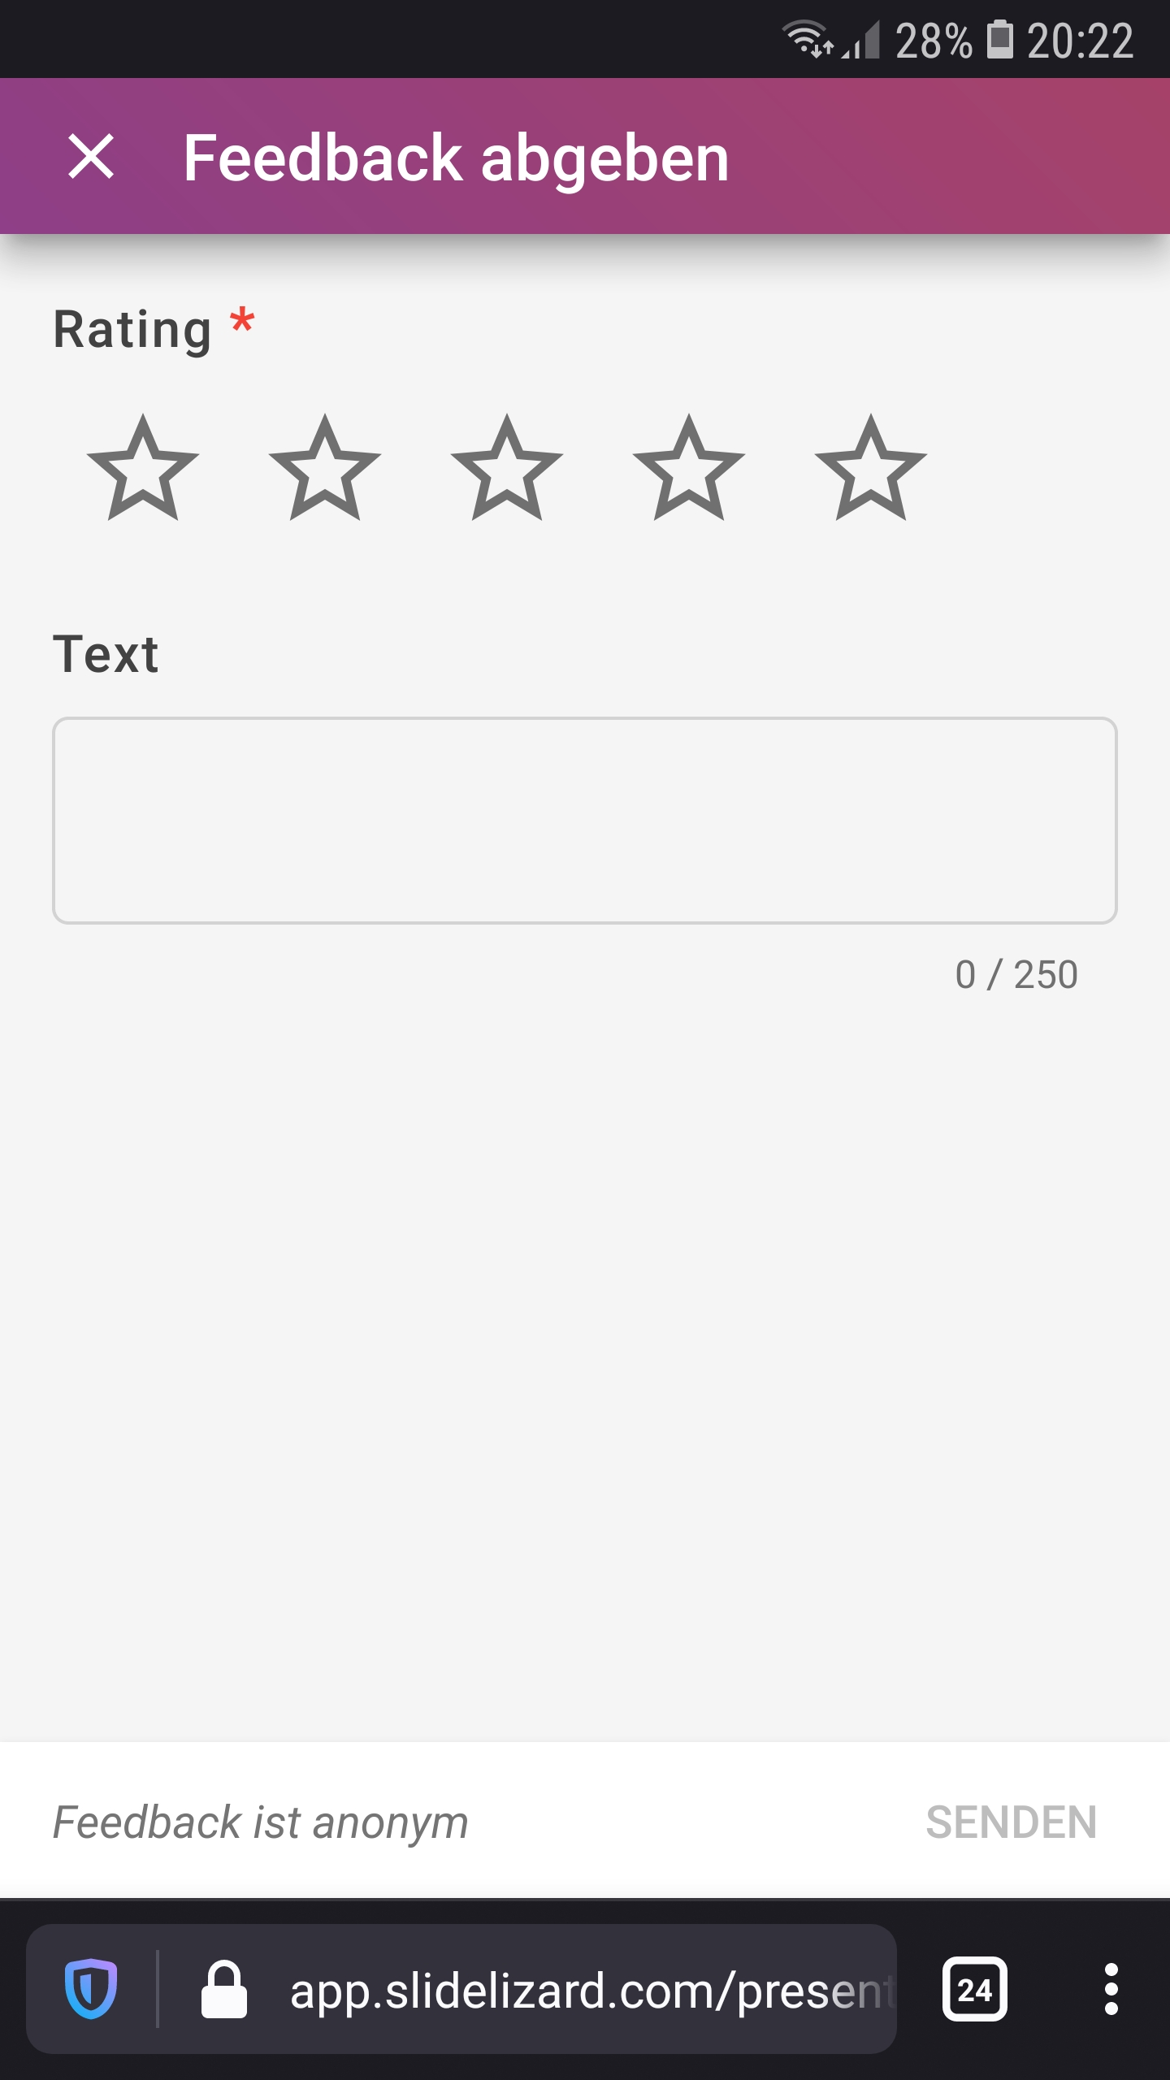
Feedback on the introductory event
Average 4.43 out of 5 stars from 37 reviews
Constructive criticism
  Partly too much information
  Request for more interaction and examples
  Time management
  Occasional technical problems

Slide 12
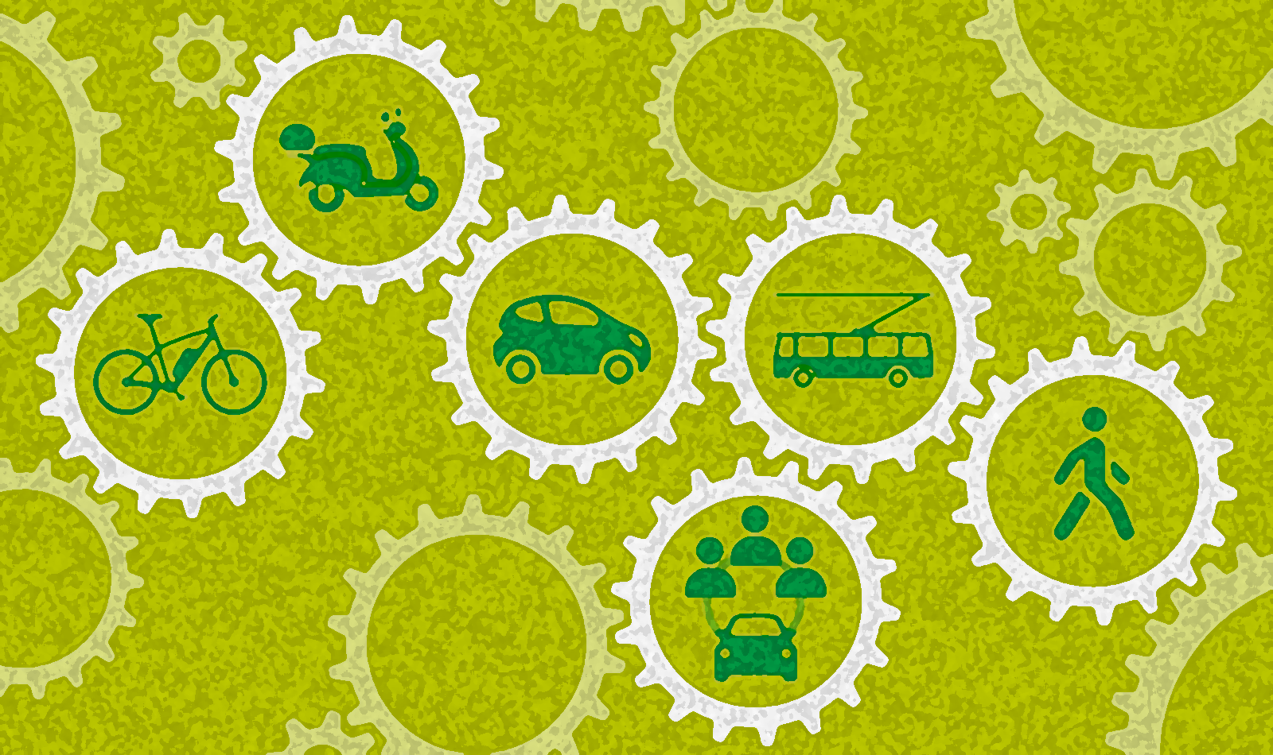
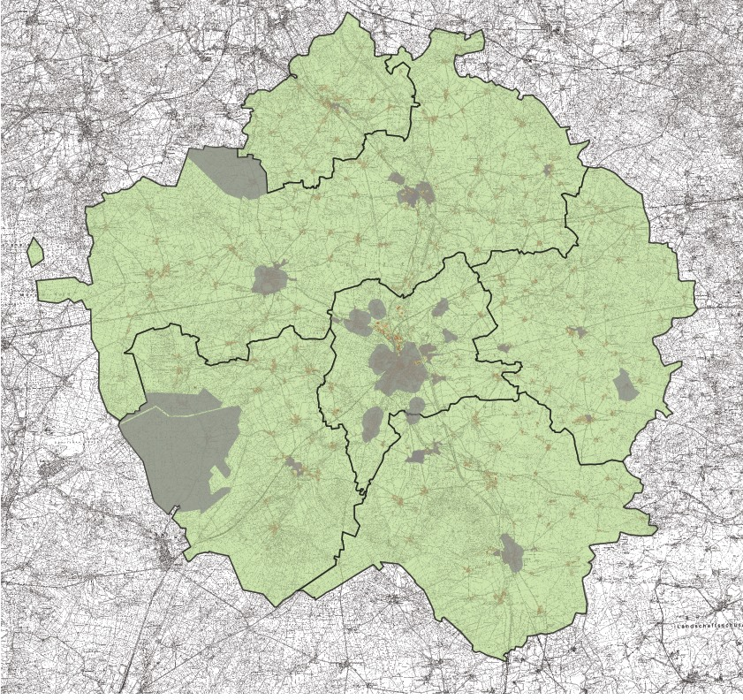
Mobility in the region of Uelzen
How do you move through your region?
What does mobility have to do with sustainability?
What role can AI take here?

Slide 13
Project Workshop Mobility
Results of the Student Survey, January 24, 2020
I am happy with... | do not agree (1) | rather disagree (2) | rather agree (3) | fully agree (4) | no specification | Number of participants (N) | Average value
the bus connections at my place during the week. | ○ | ○ | ○ | ○ | ○ | 150 | 2,28
the bus connections at my place on weekends. | ○ | ○ | ○ | ○ | ○ | 145 | 1,71
the connection to surrounding cities by train. | ○ | ○ | ○ | ○ | ○ | 171 | 2,71
the possibilities within the region to get around without a car. | ○ | ○ | ○ | ○ | ○ | 173 | 2,15

Slide 14
Project Workshop Mobility
Results of the Student Survey, January 24, 2020
The most frequently used means of transport for students at BBS are the car, bicycle and train
The possibilities of getting around in the region without a car is considered rather poor
Especially on weekends there are hardly any bus connections offered
„Ohne Auto geht auf dem Land fast nichts“
Almost nothing works in the rural area without a car
(Ulrich Becker, ADAC Vizepräsident)

Slide 15
Results of the Student Survey, January 24, 2020
Would you be able to not own a car if this had advantages (e.g. cheaper price, environmental friendliness) and you could use the following options? | do not agree (1) | rather disagree (2) | rather agree (3) | fully agree (4) | no specification | Number of participants(N) | Average value
As a driver's license holder, you can use the app to book cars from a provider that are freely available in the region on a minute-by-minute basis. After your trip, you simply park the car somewhere in the public space of your region. | ○ | ○ | ○ | ○ | ○ | 179 | 2,24
Using the carpooling app, you can book a car with a driver at short notice to take you and other passengers to your destination. | ○ | ○ | ○ | ○ | ○ | 179 | 1,96
You can use the app to book a self-driving car at short notice that will take you to your destination fully automatically. A driver's license is not necessary. | ○ | ○ | ○ | ○ | ○ | 179 | 2,20
Car-Sharing
Ride-Sharing / Ride-Pooling
Autonomous driving
Notes:
Car-Sharing gibt es auch in der Form, dass die Autos an einem festgelegten Parkplatz abgestellt werden müssen.
Ridesharing (bei privaten Anbietern, Bsp. “Uber”) und Ridepooling (wenn von Kommunen betrieben). Man kann sich dies als eine Mischung aus Taxi und öffentlicher Nahverkehr in Form von Busen vorstellen (auch preislich bewegt es sich meist dazwischen). Im Idealfall werden dabei Dritte bei sowieso durchgeführten Fahrten mitgenommen.

Slide 16
AI Workshop "Mobility "
Could AI-based technologies be a solution to the region's problems?
Develop your own ideas for the future in Uelzen!

Slide 17

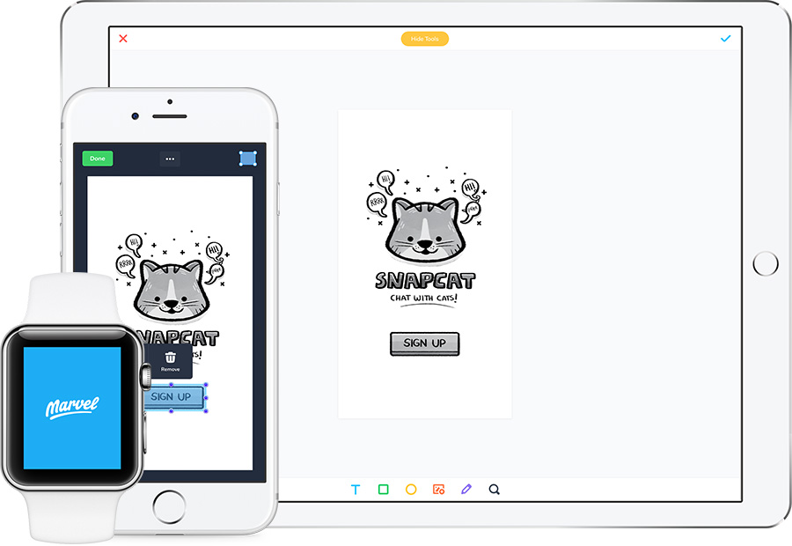
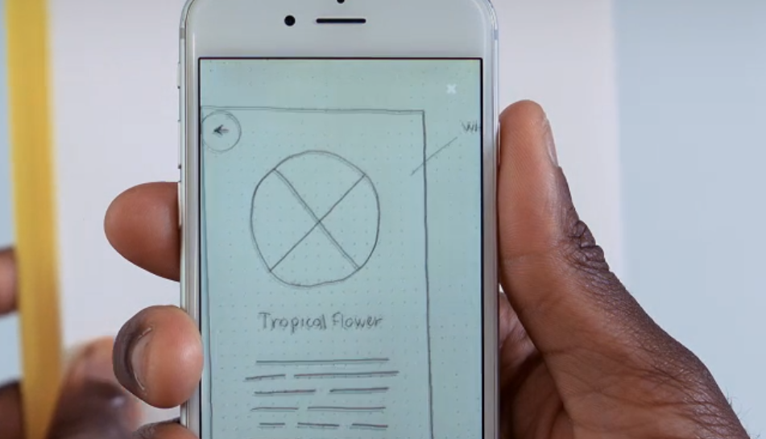
Develop your own app idea with
App for developing your own "click prototypes“
Implement your own ideas for an AI-based application according to your wishes and ideas
Use existing templates, pictures from the internet or sketch your ideas on a sheet of paper and take a picture of them
Notes:
https://marvelapp.com/

Slide 18
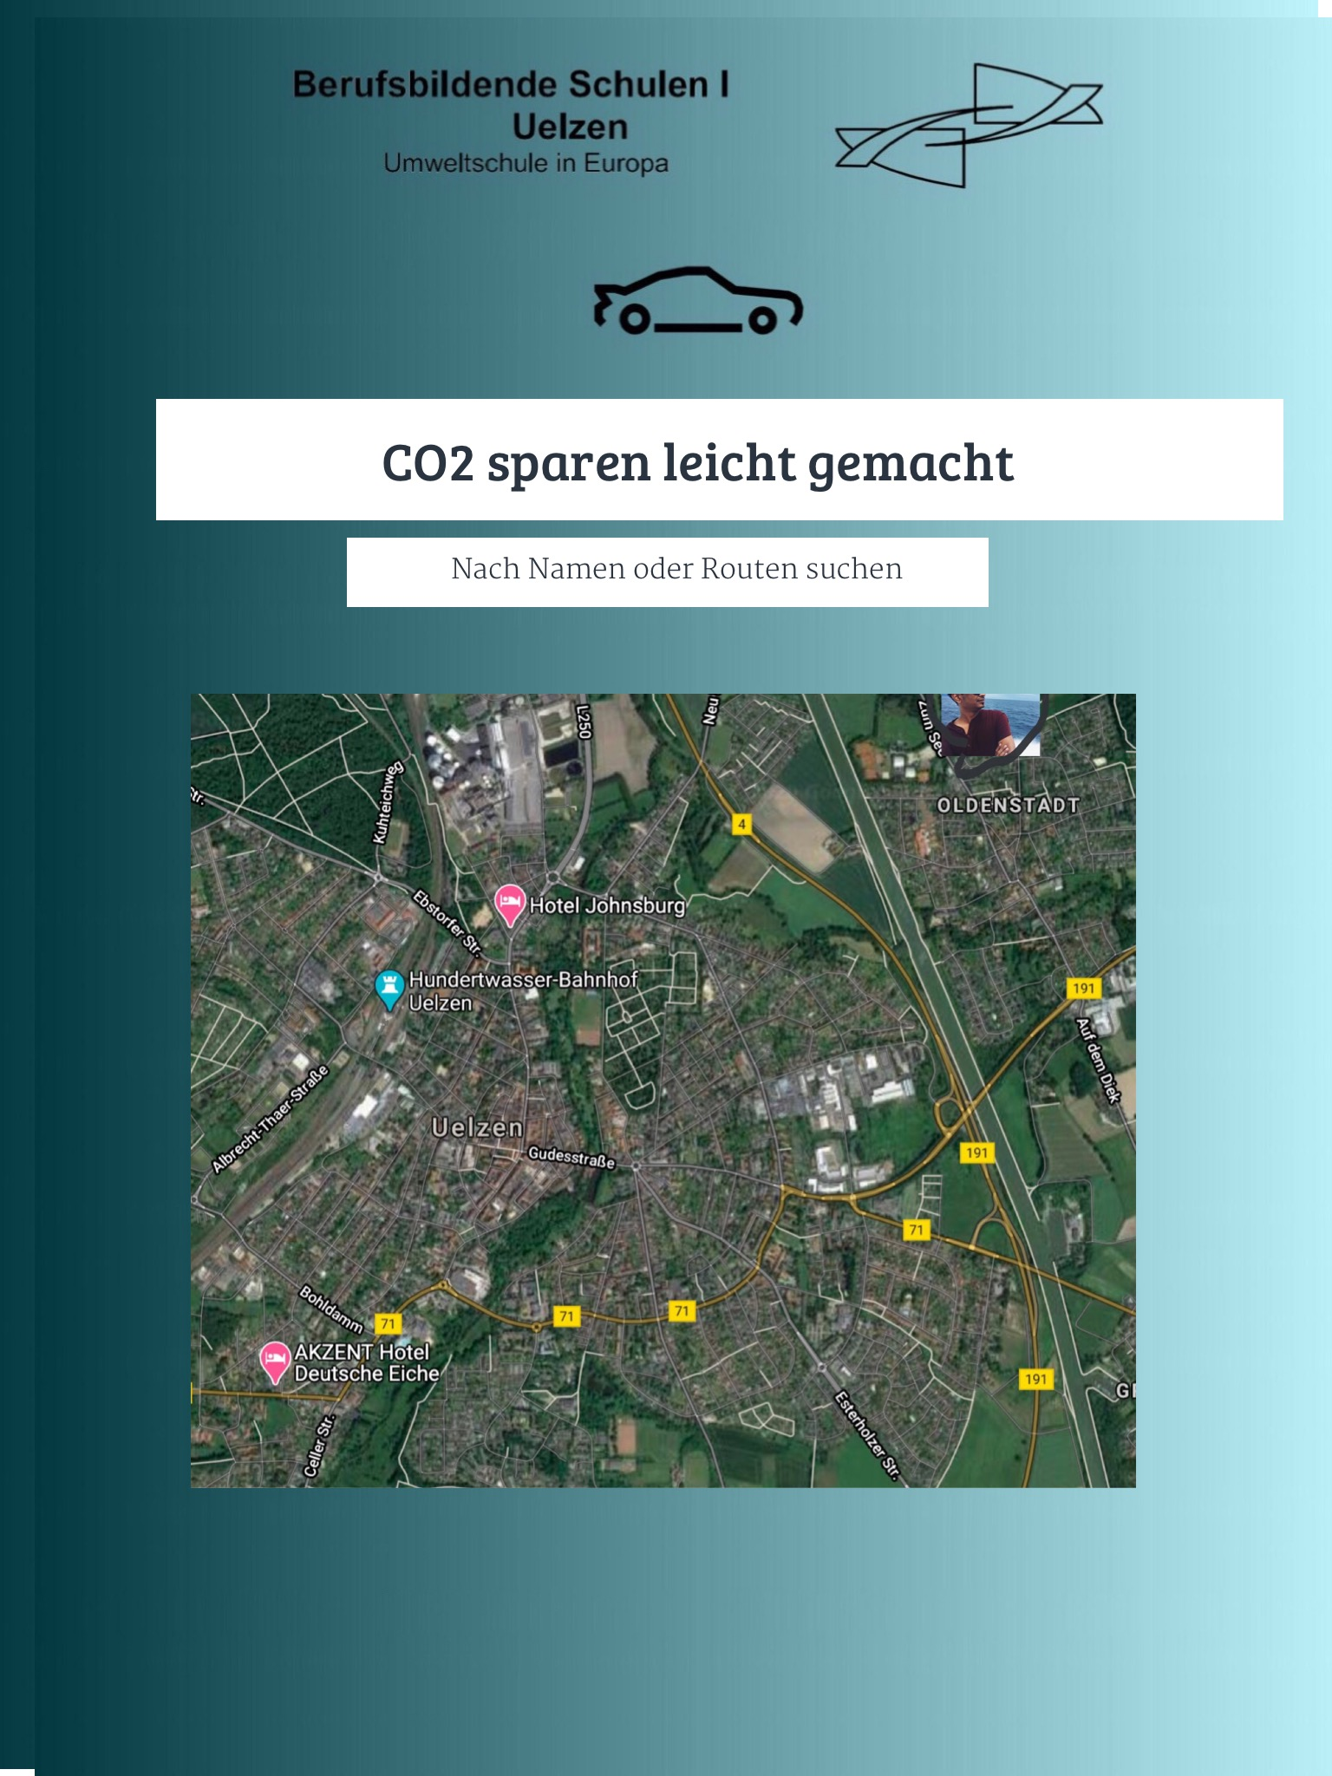
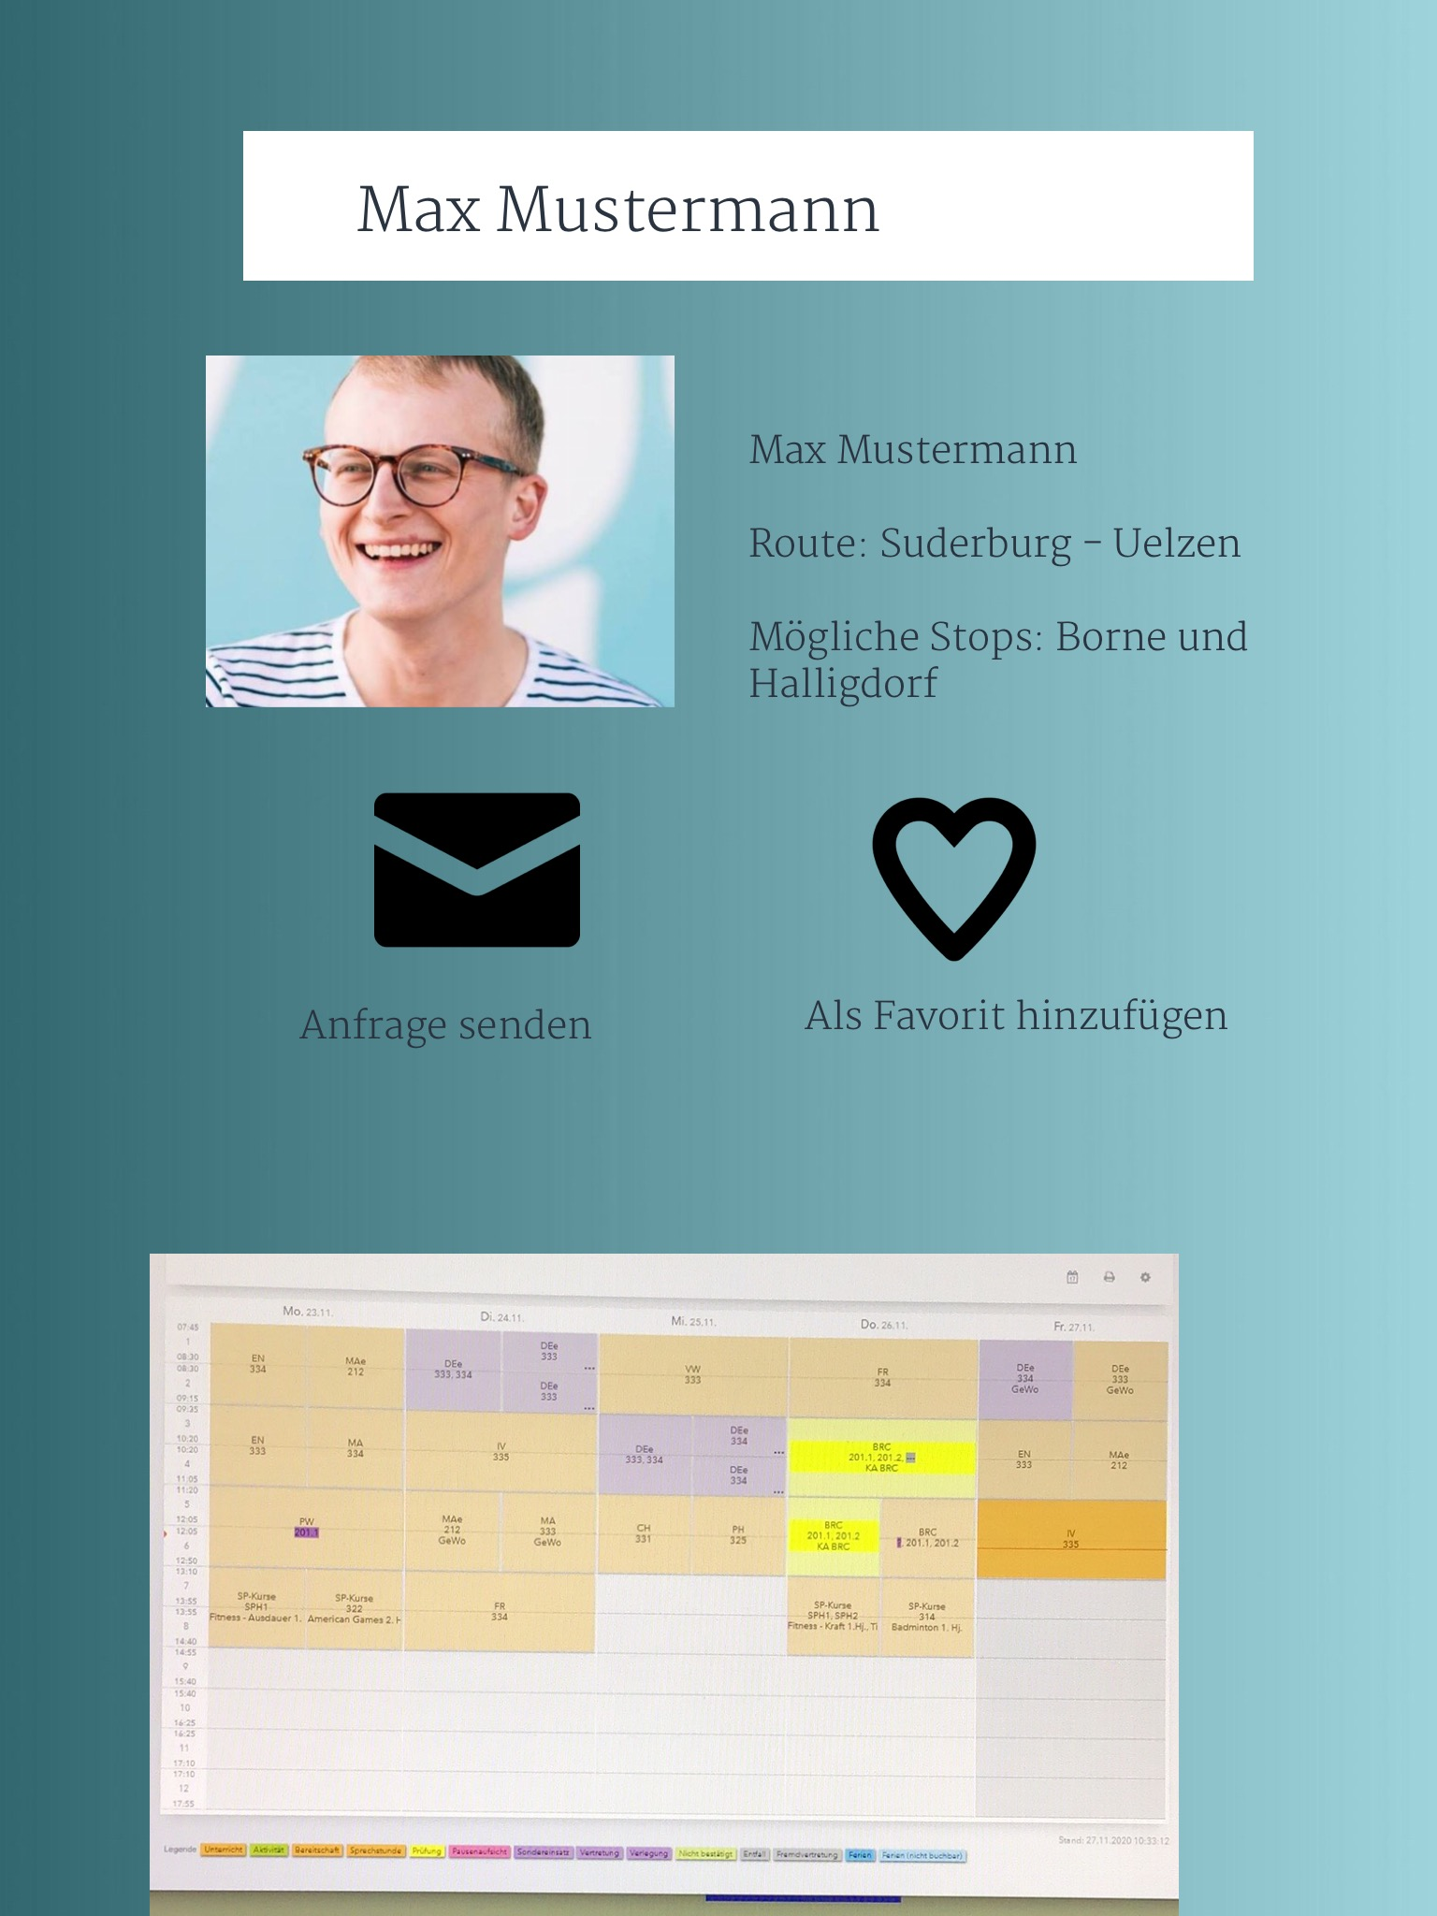
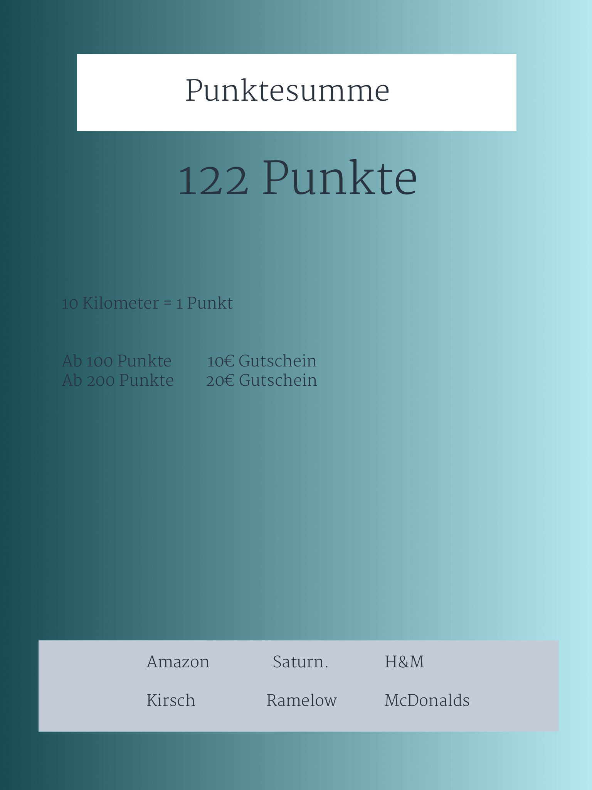
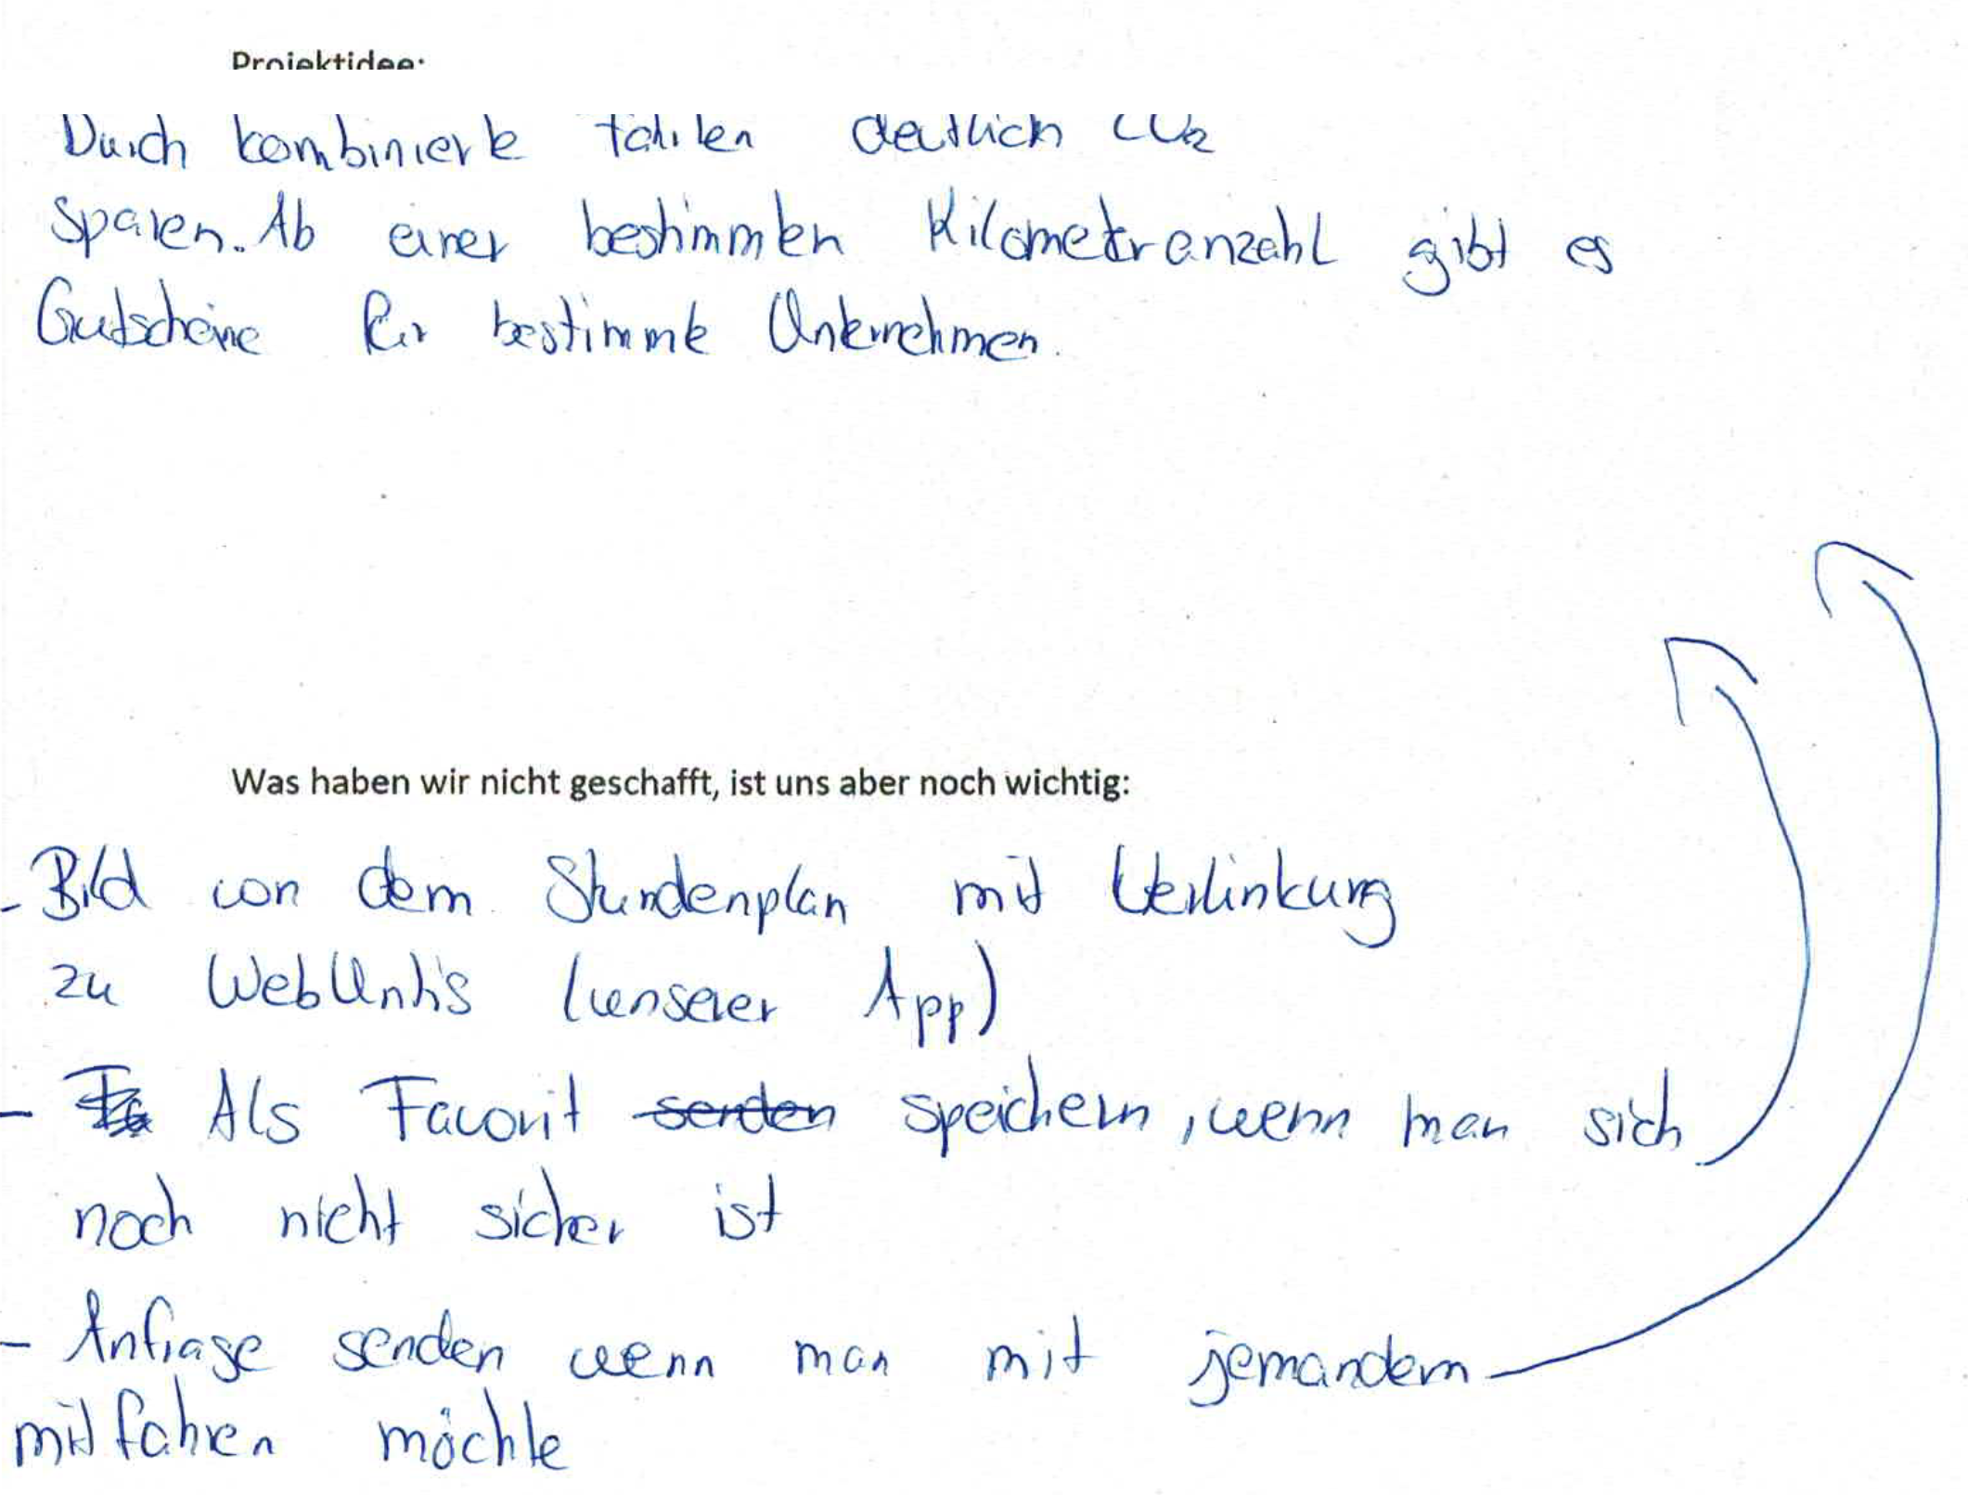
Results of the workshop "Mobility" - BBS Ride-Pooling

Slide 19
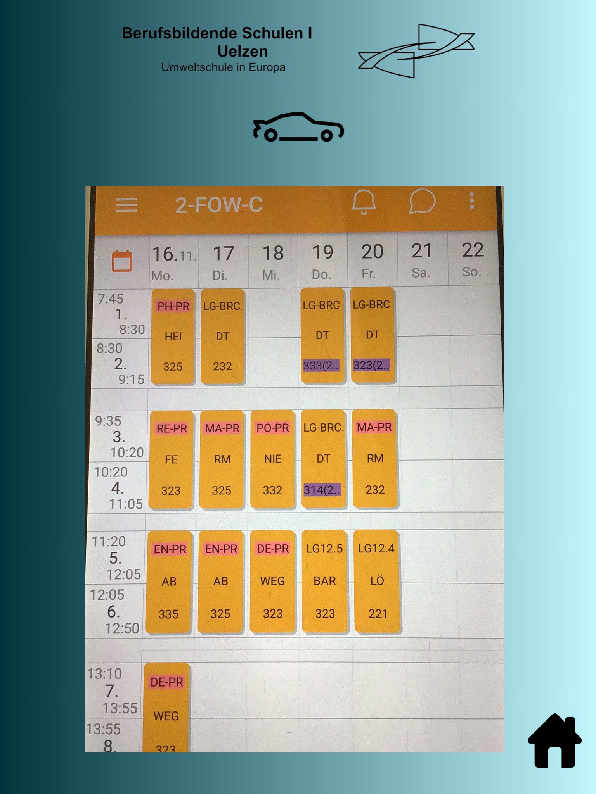
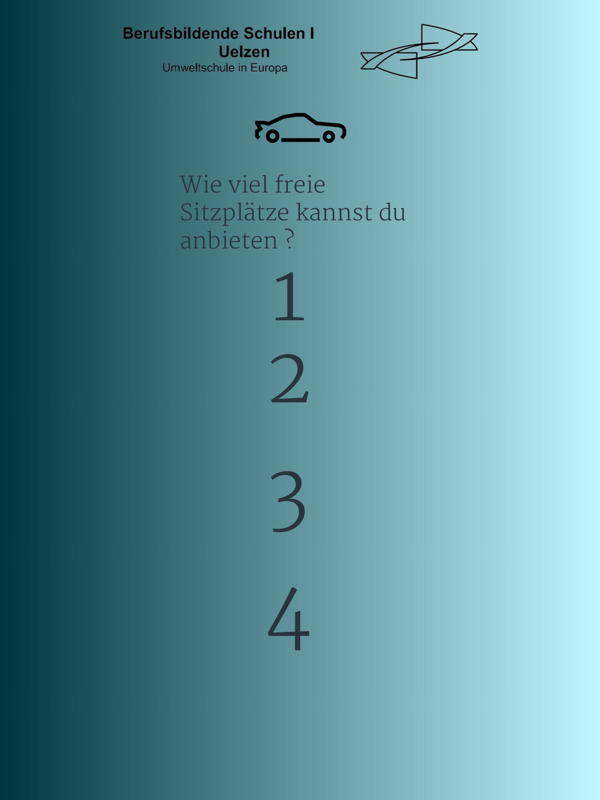
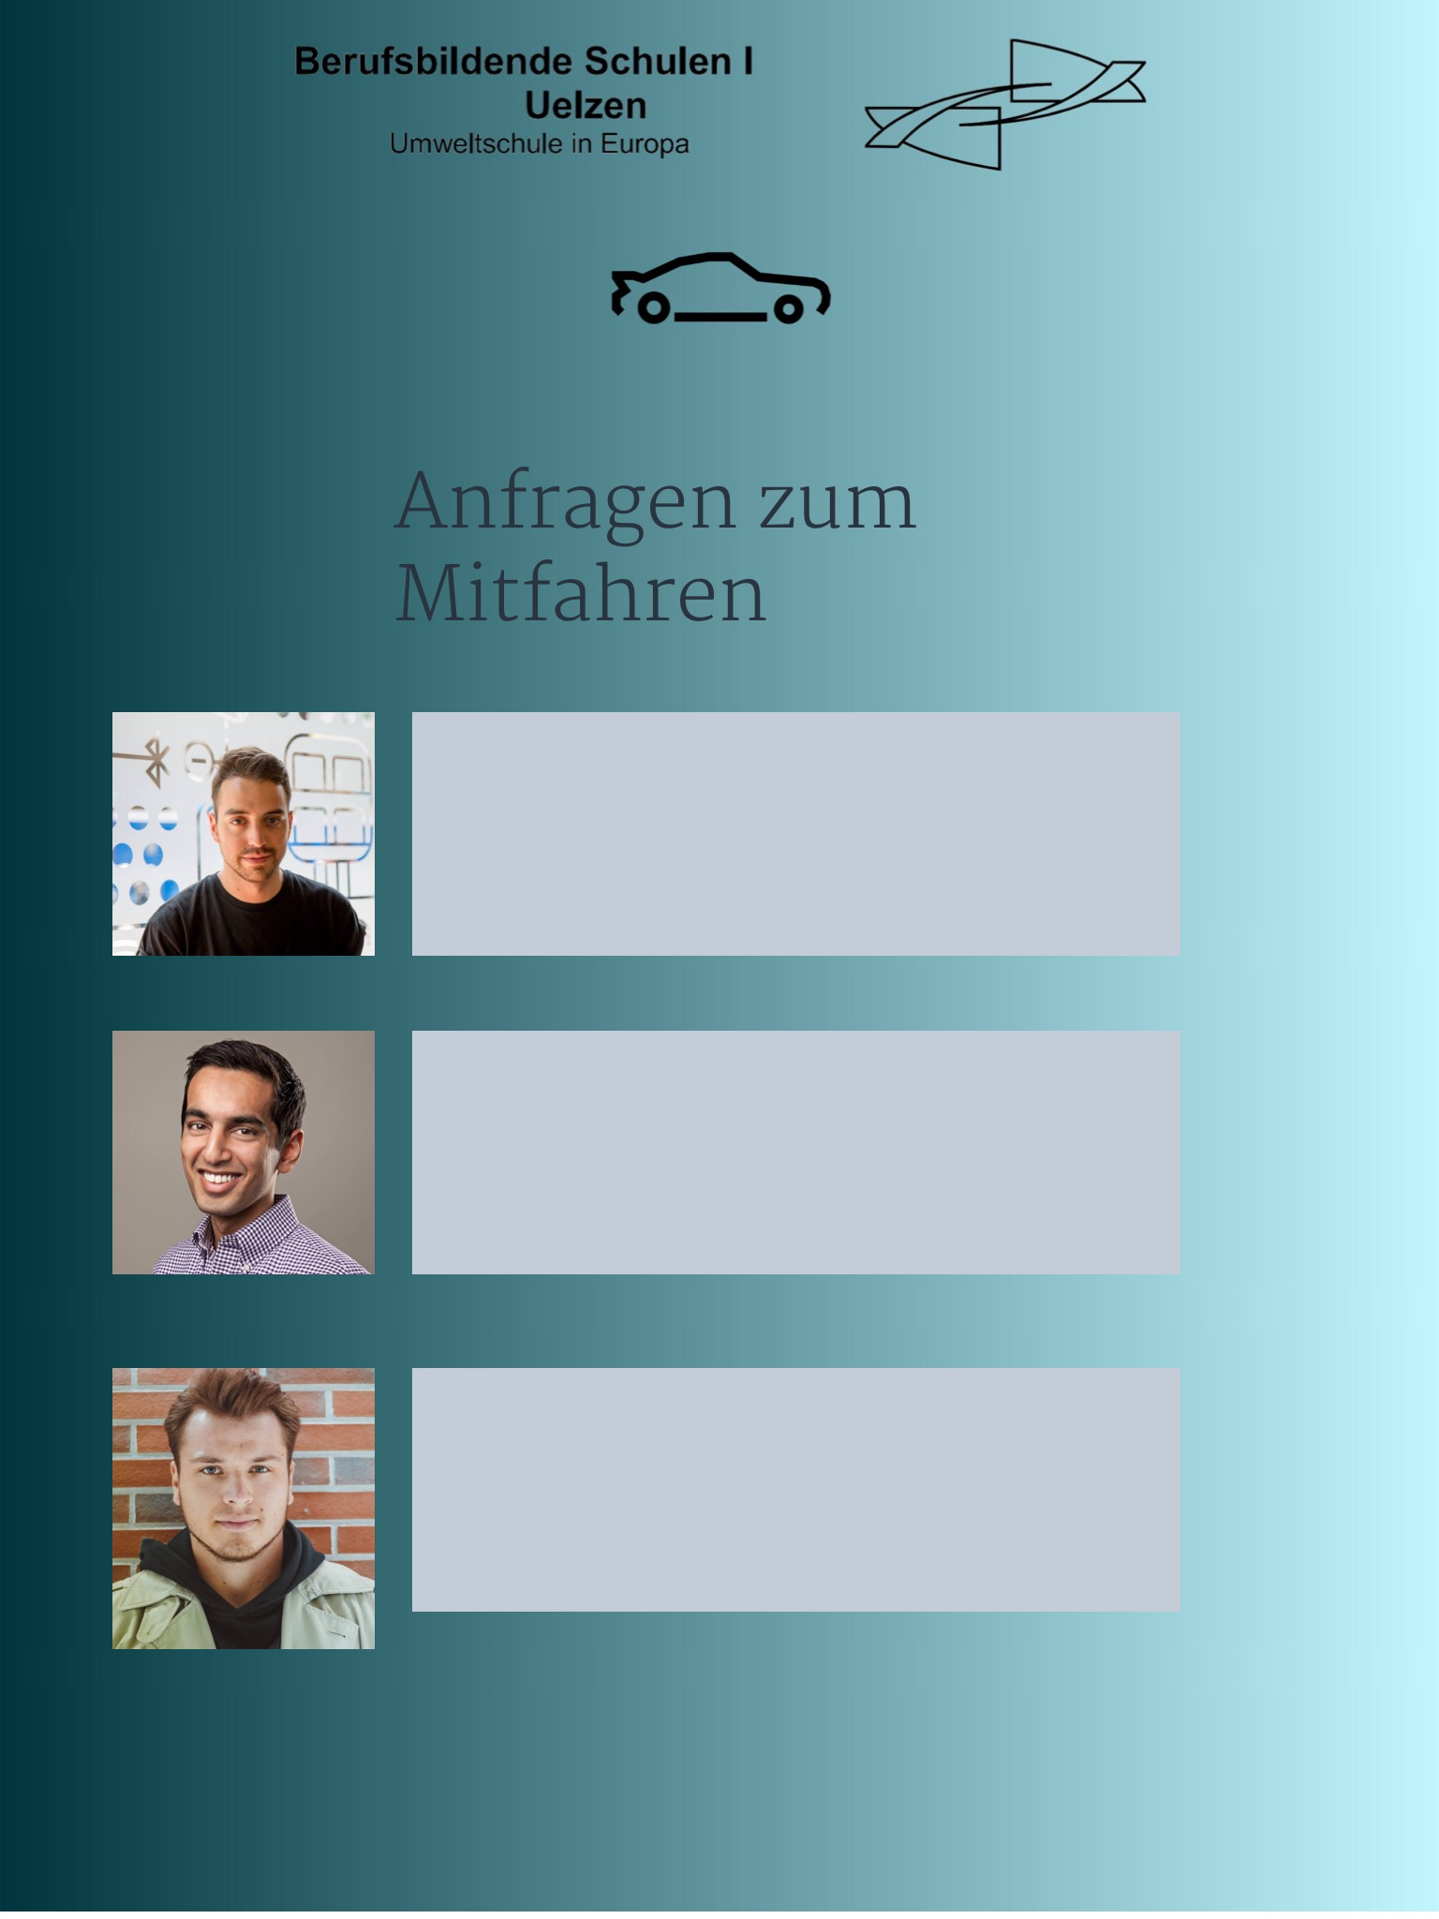
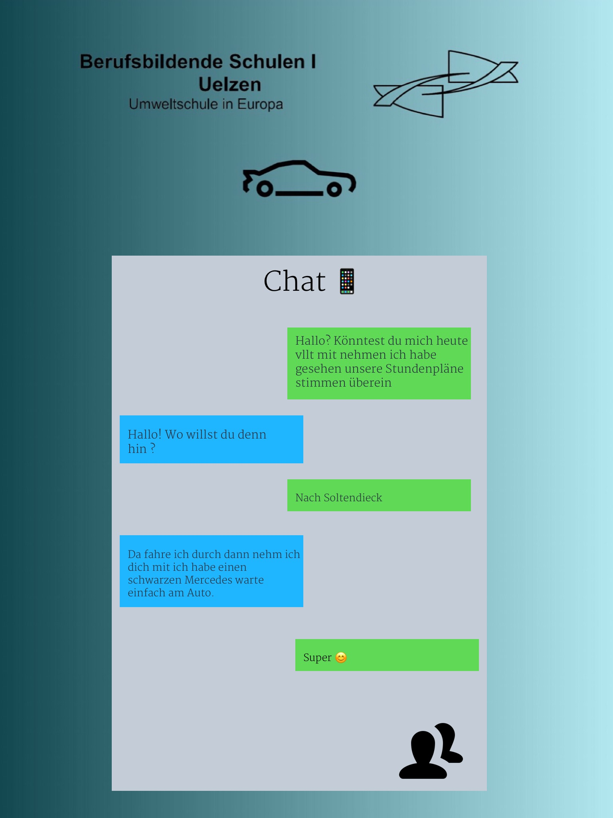
Results of the workshop "Mobility" - BBS Ride-Pooling

Slide 20
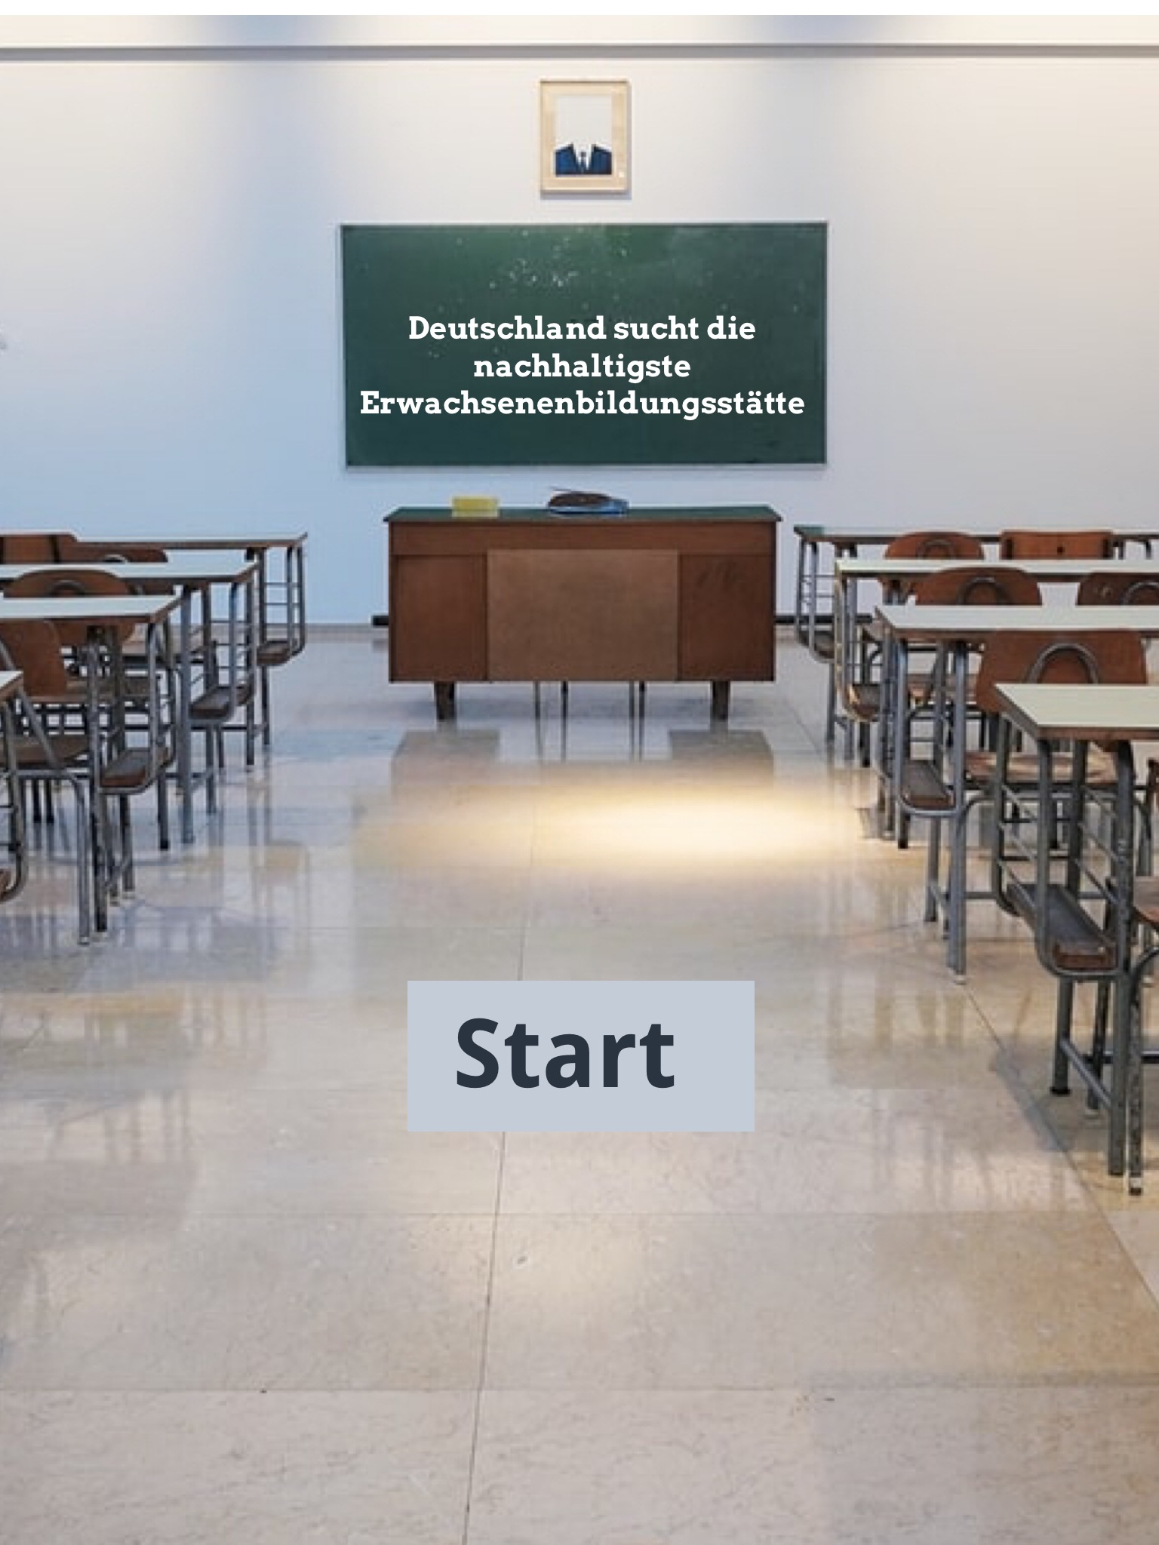
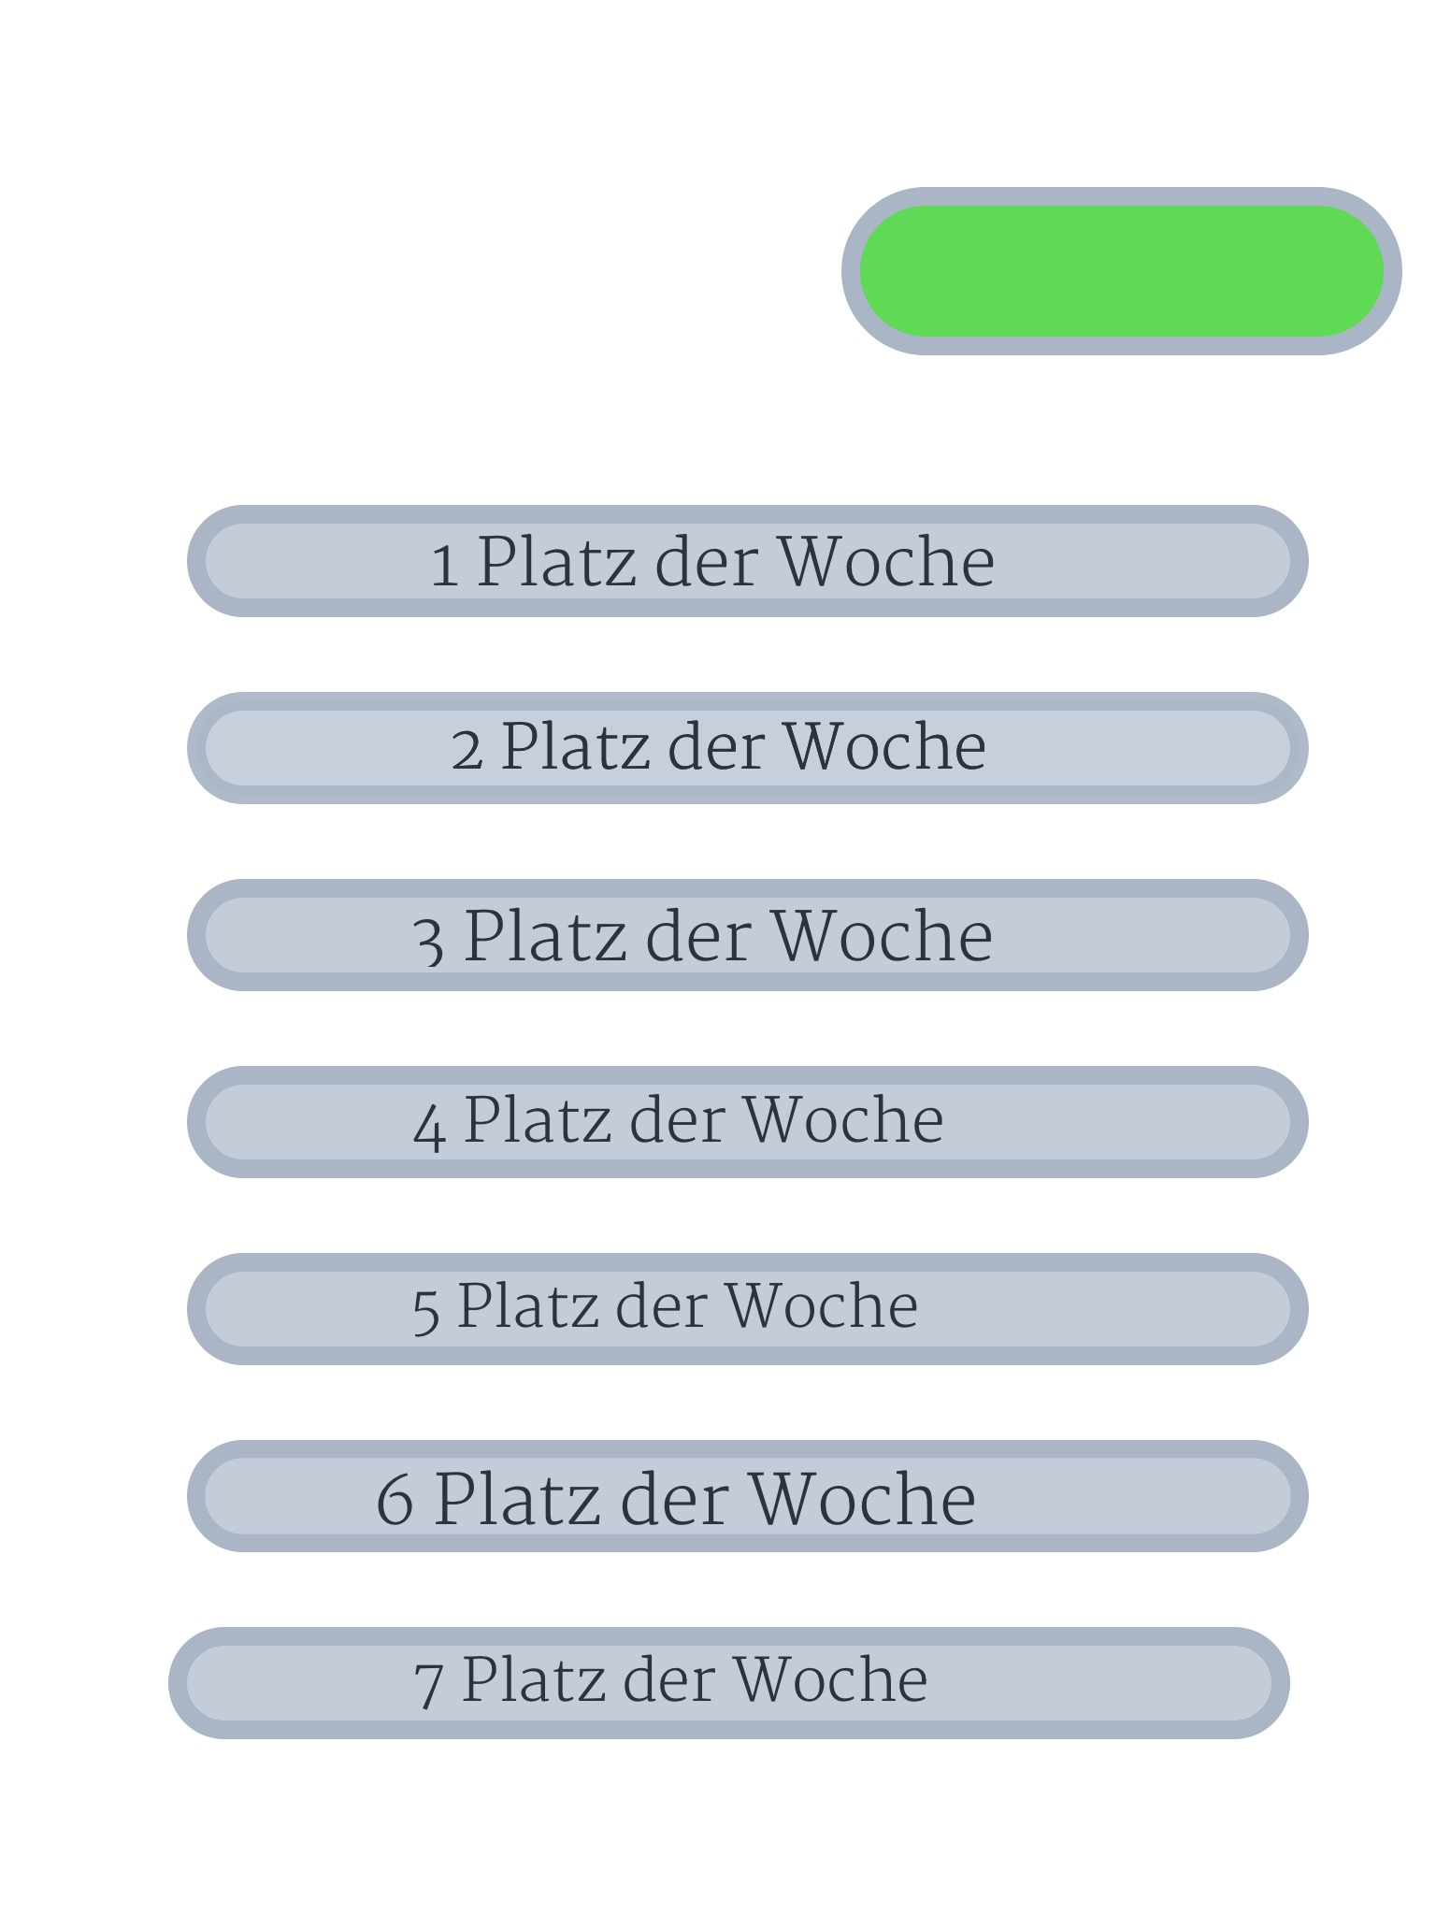

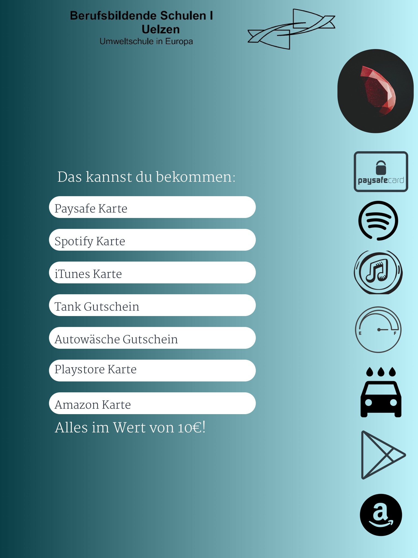
Results of the workshop "Mobility" - BBS Ride-Pooling
Motivation / reward system

Slide 21
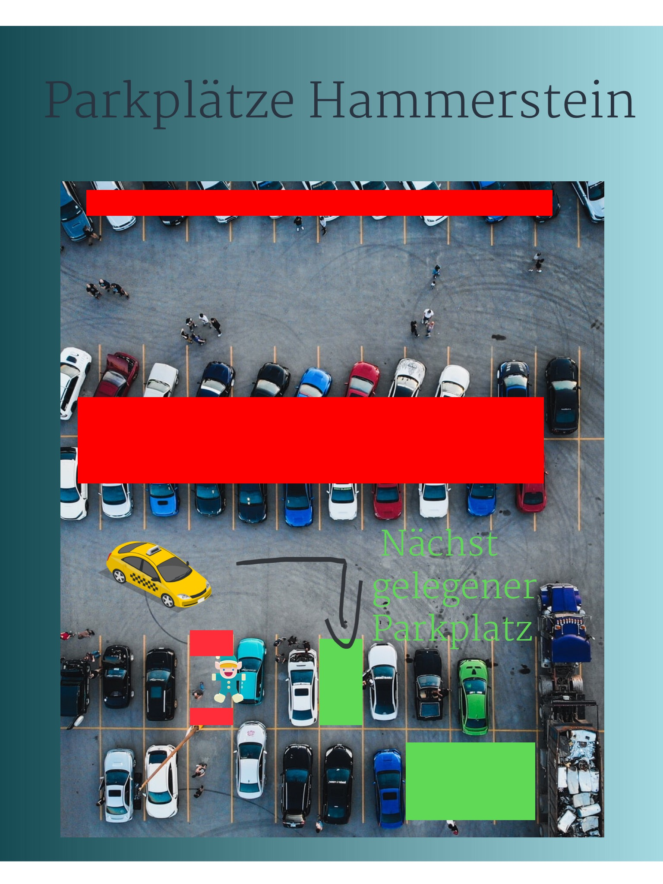
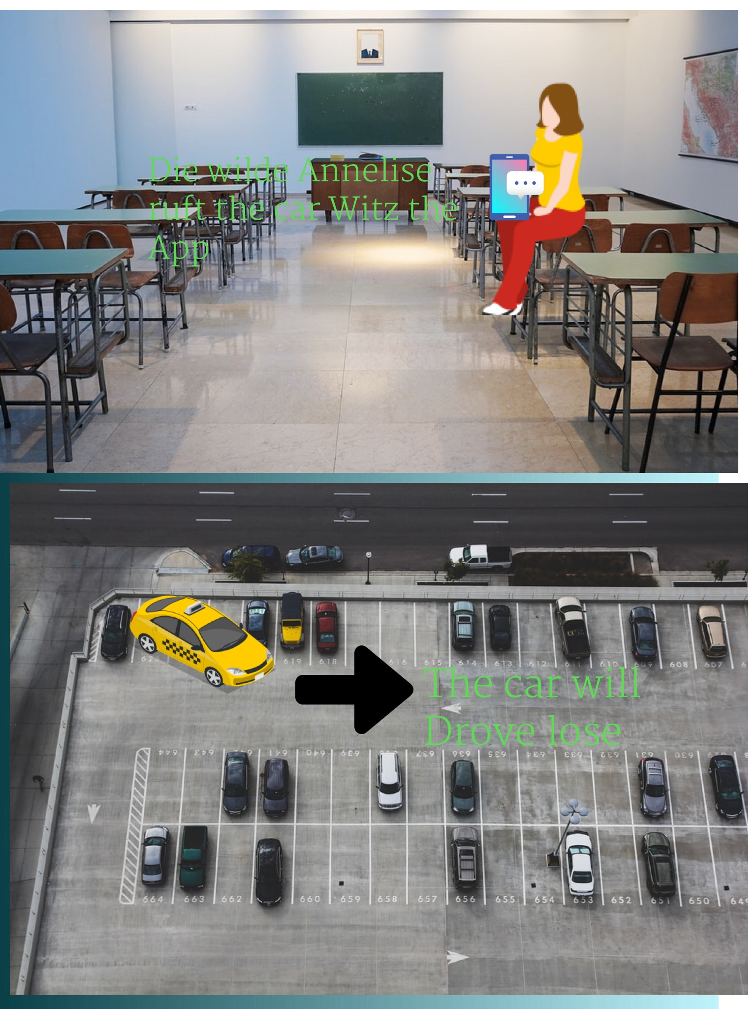
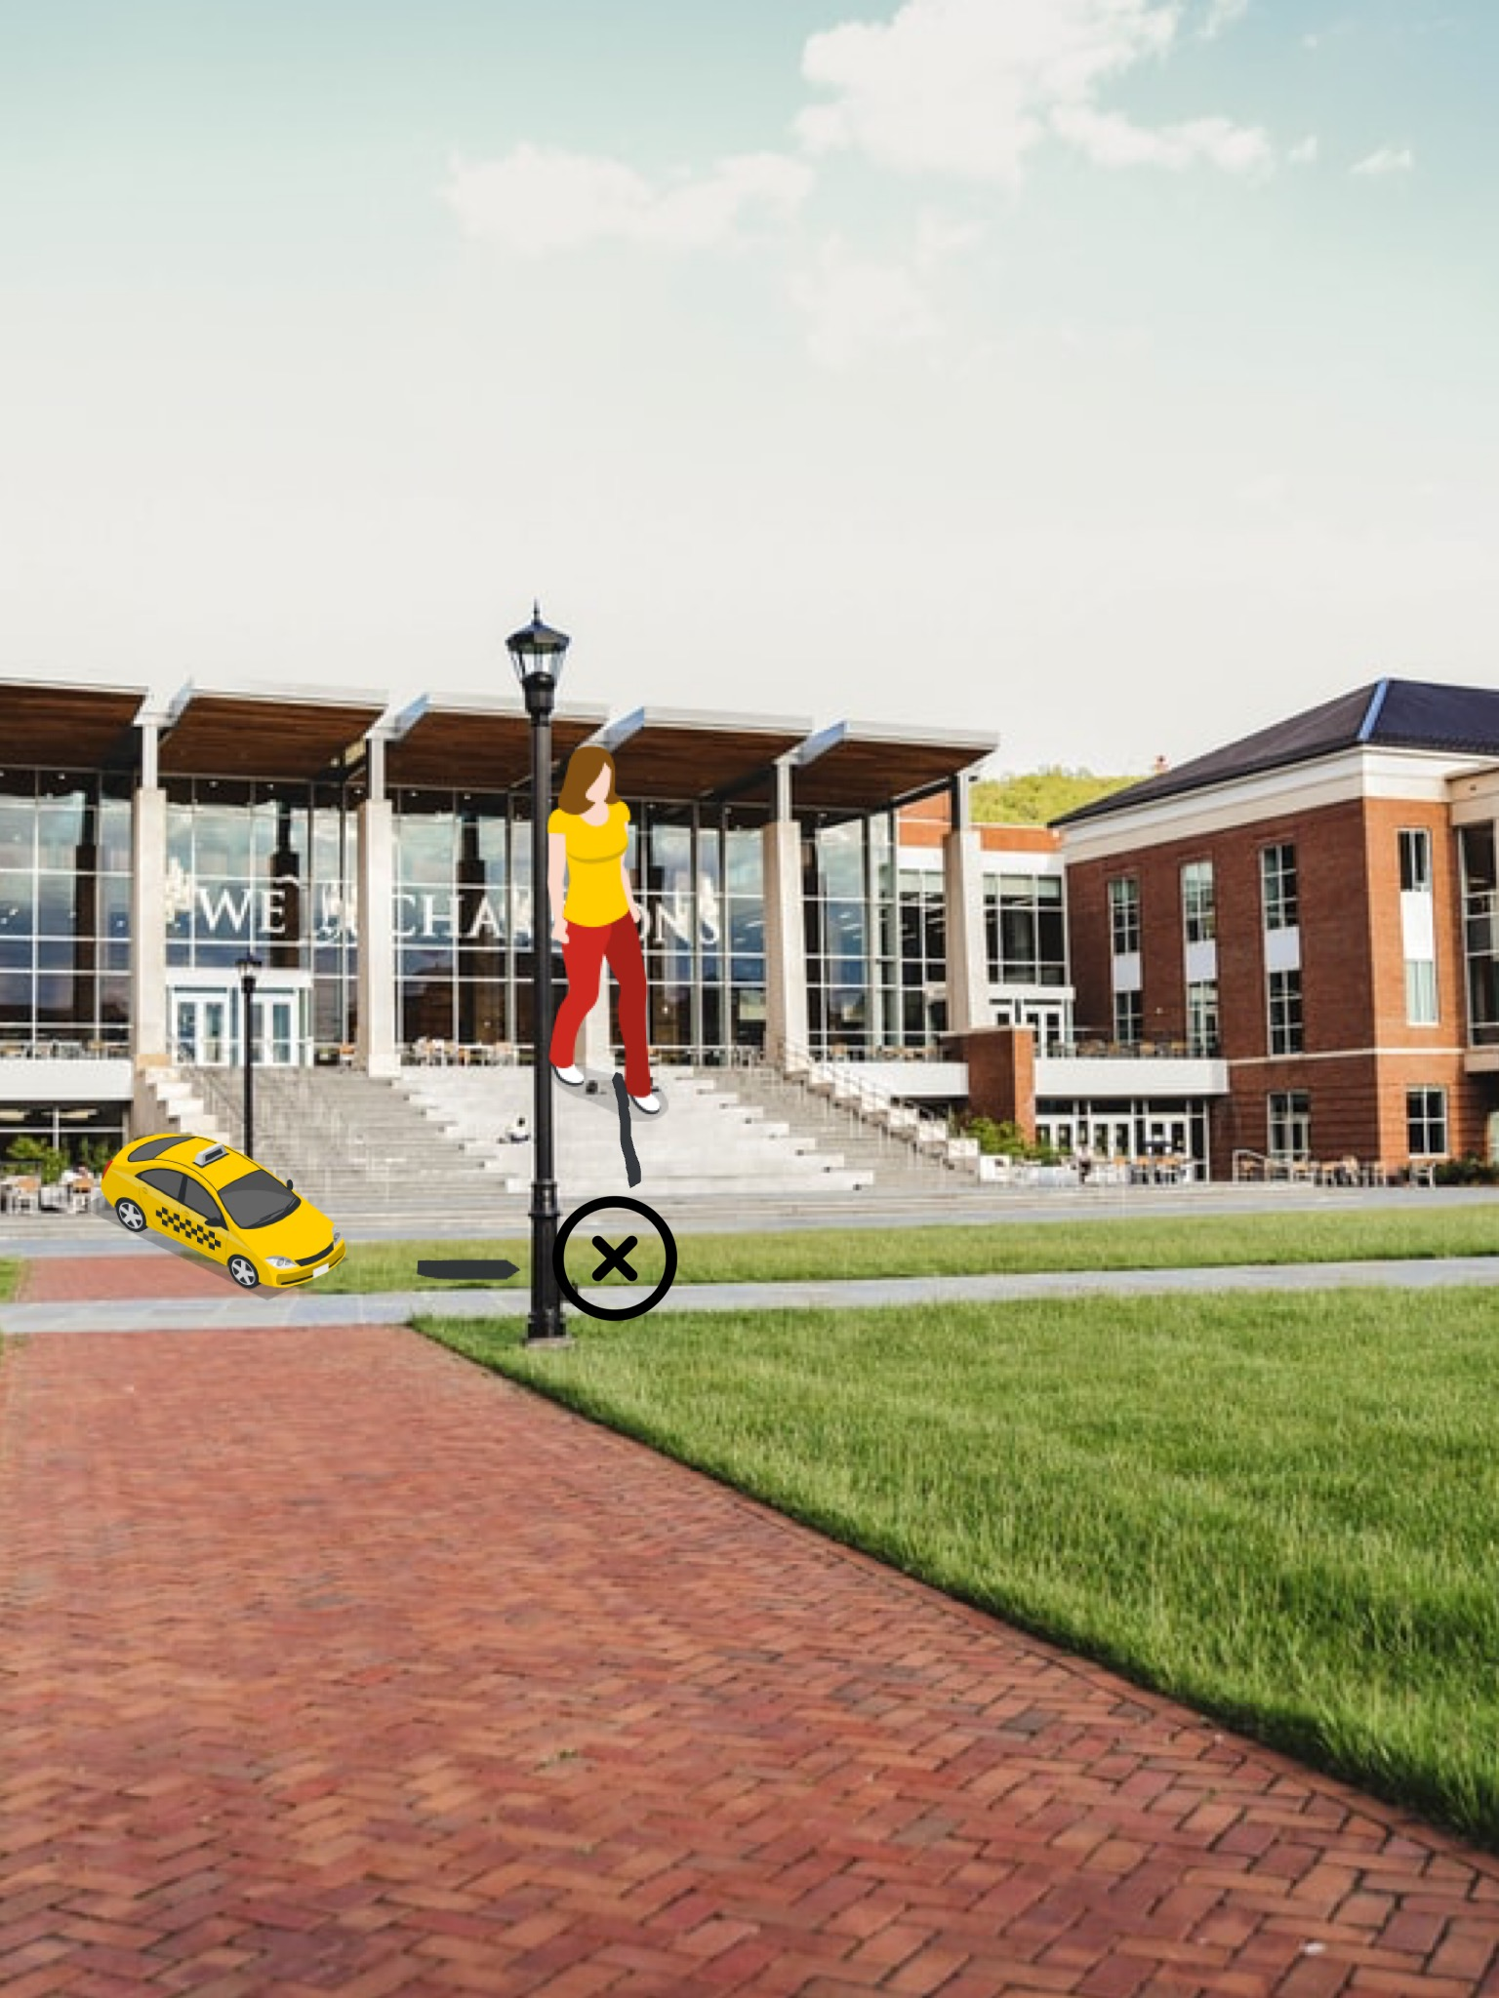
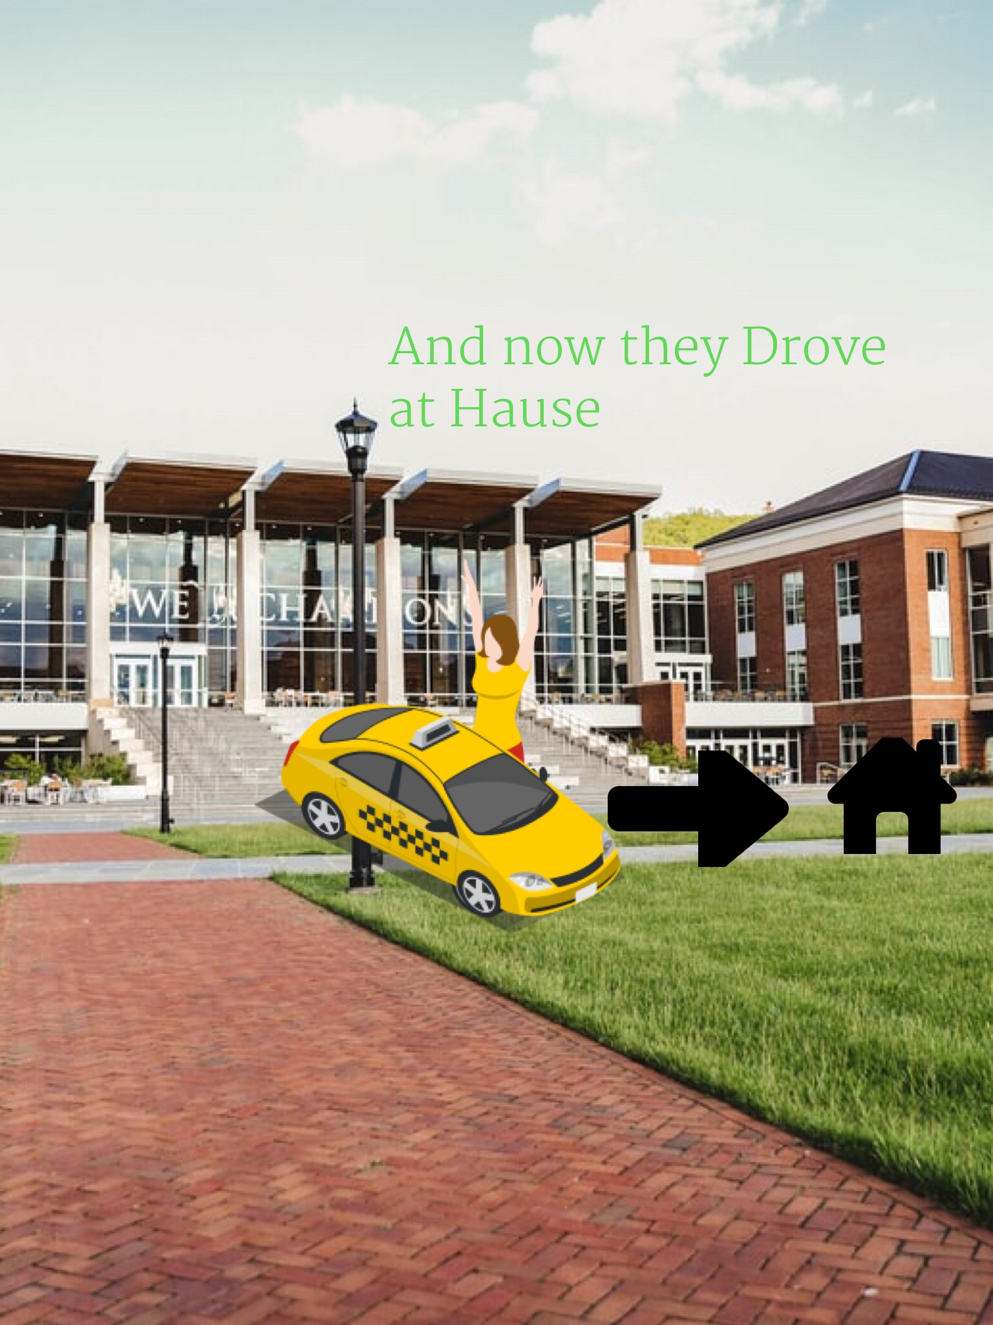
Results of the workshop "Mobility"–
Autonomous parking lot search

Slide 22

Work & education in the region of Uelzen
How could learning look like in the future?
How will working life change?
What role do AI and digitalization play?

Slide 23
Results of the student survey, January 24, 2020
Conclusion for the area of work & education offer
Dissatisfied with your school preparation for a digital future
Lack of opportunities to find suitable apprenticeships and jobs locally
Little willingness to be observed at work by AI so that it can learn the work processes
High level of data security awareness regarding social networks: data is considered to be as sensitive as one's own genetic material

Slide 24
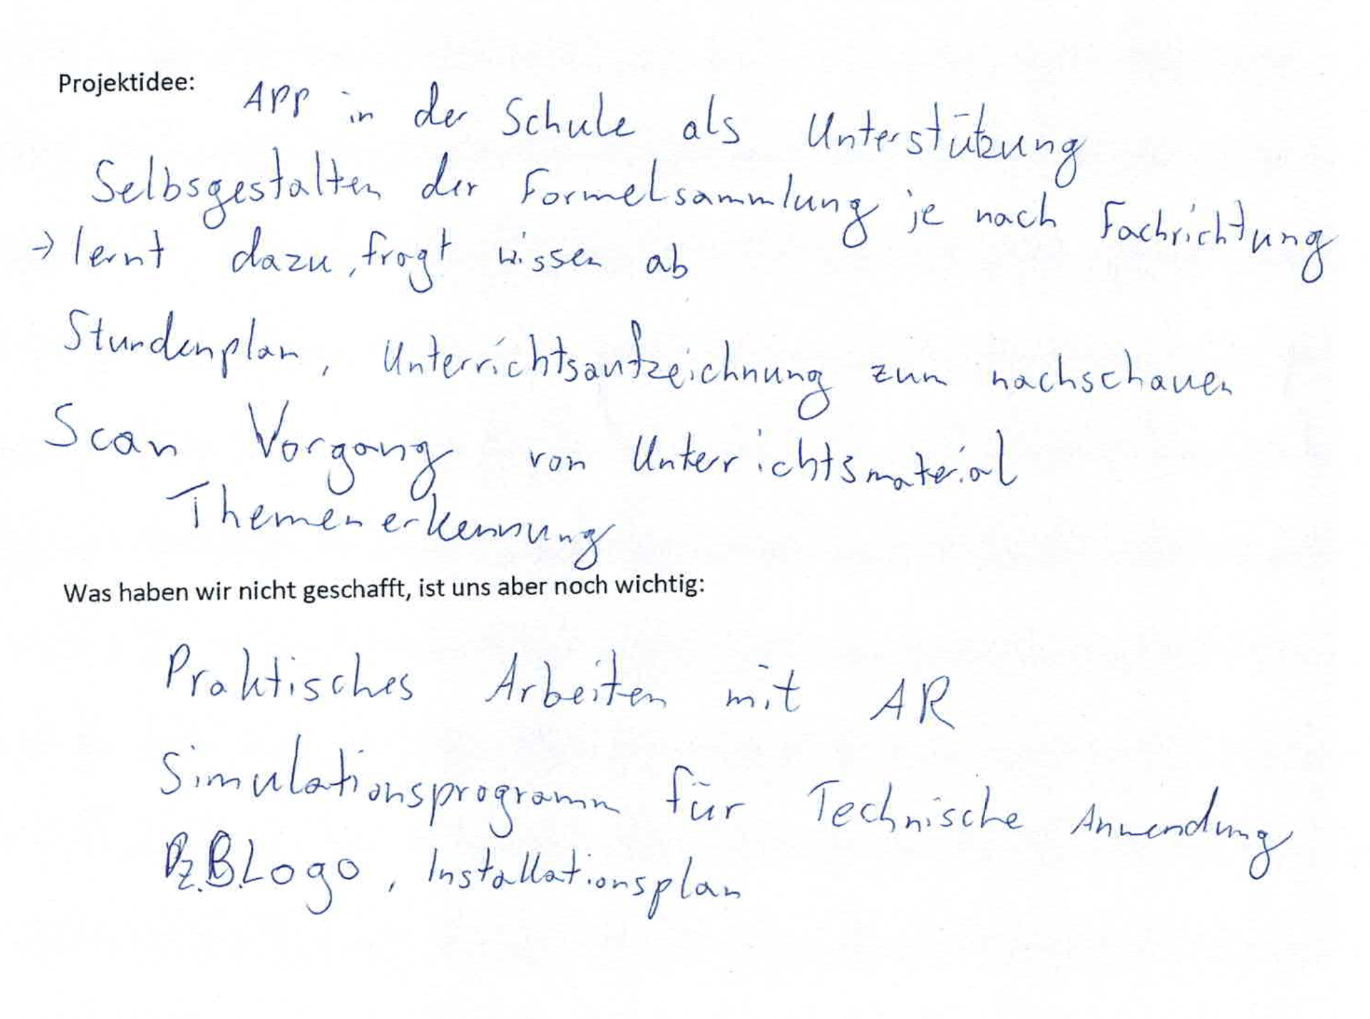
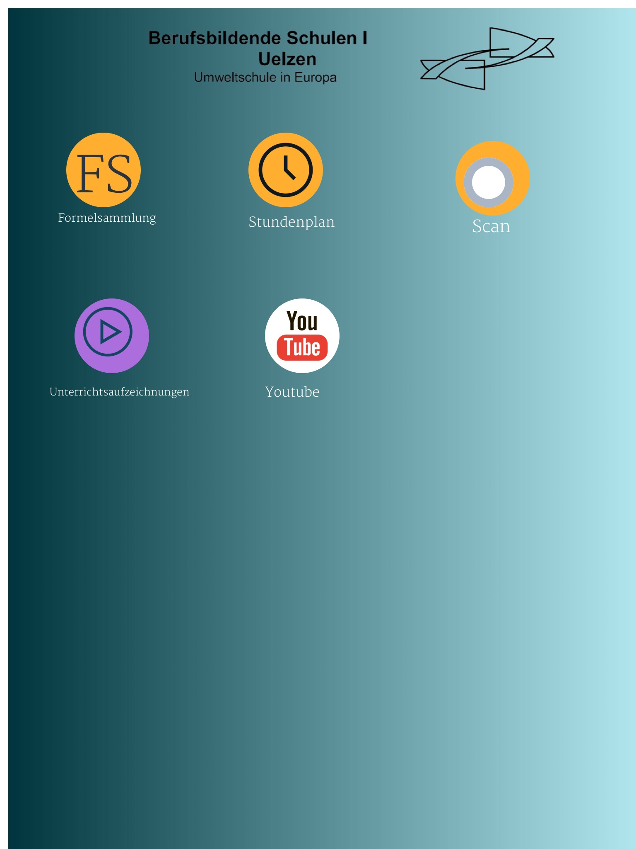
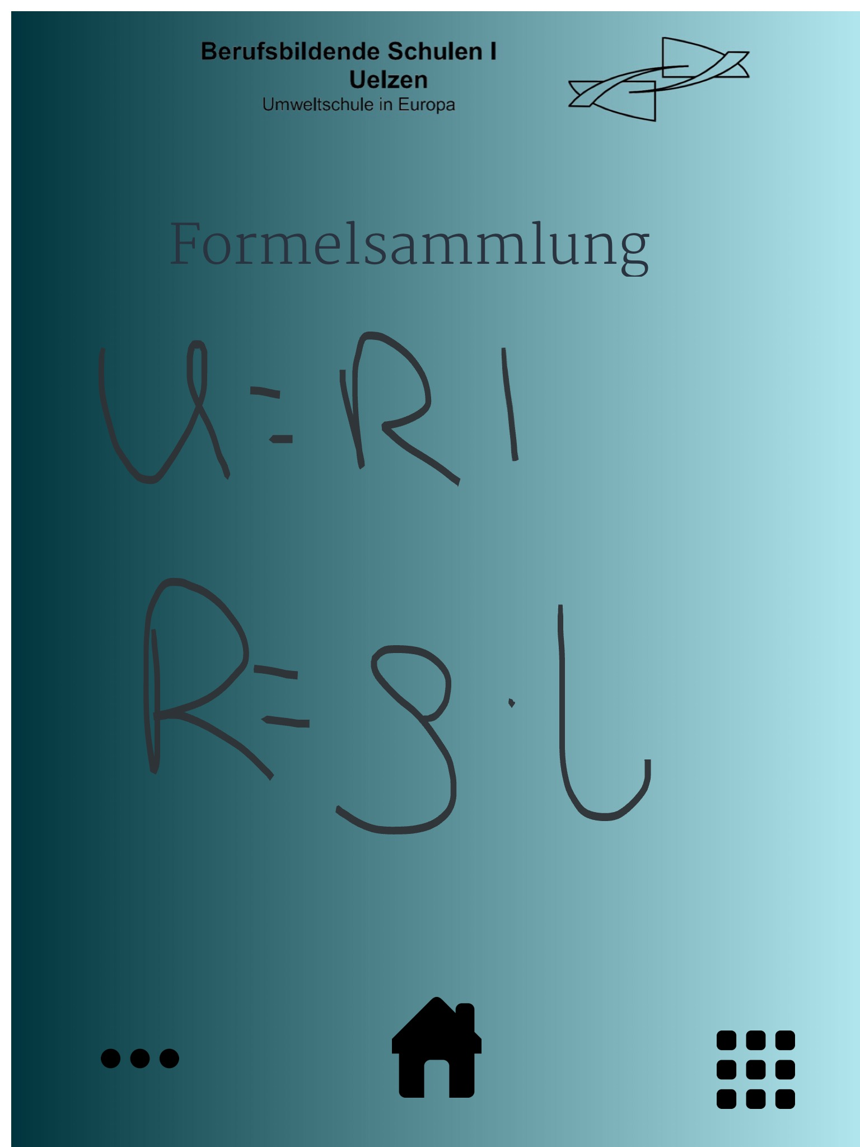
Results of the workshop "Work and education" –
Learning guide for electricians

Slide 25
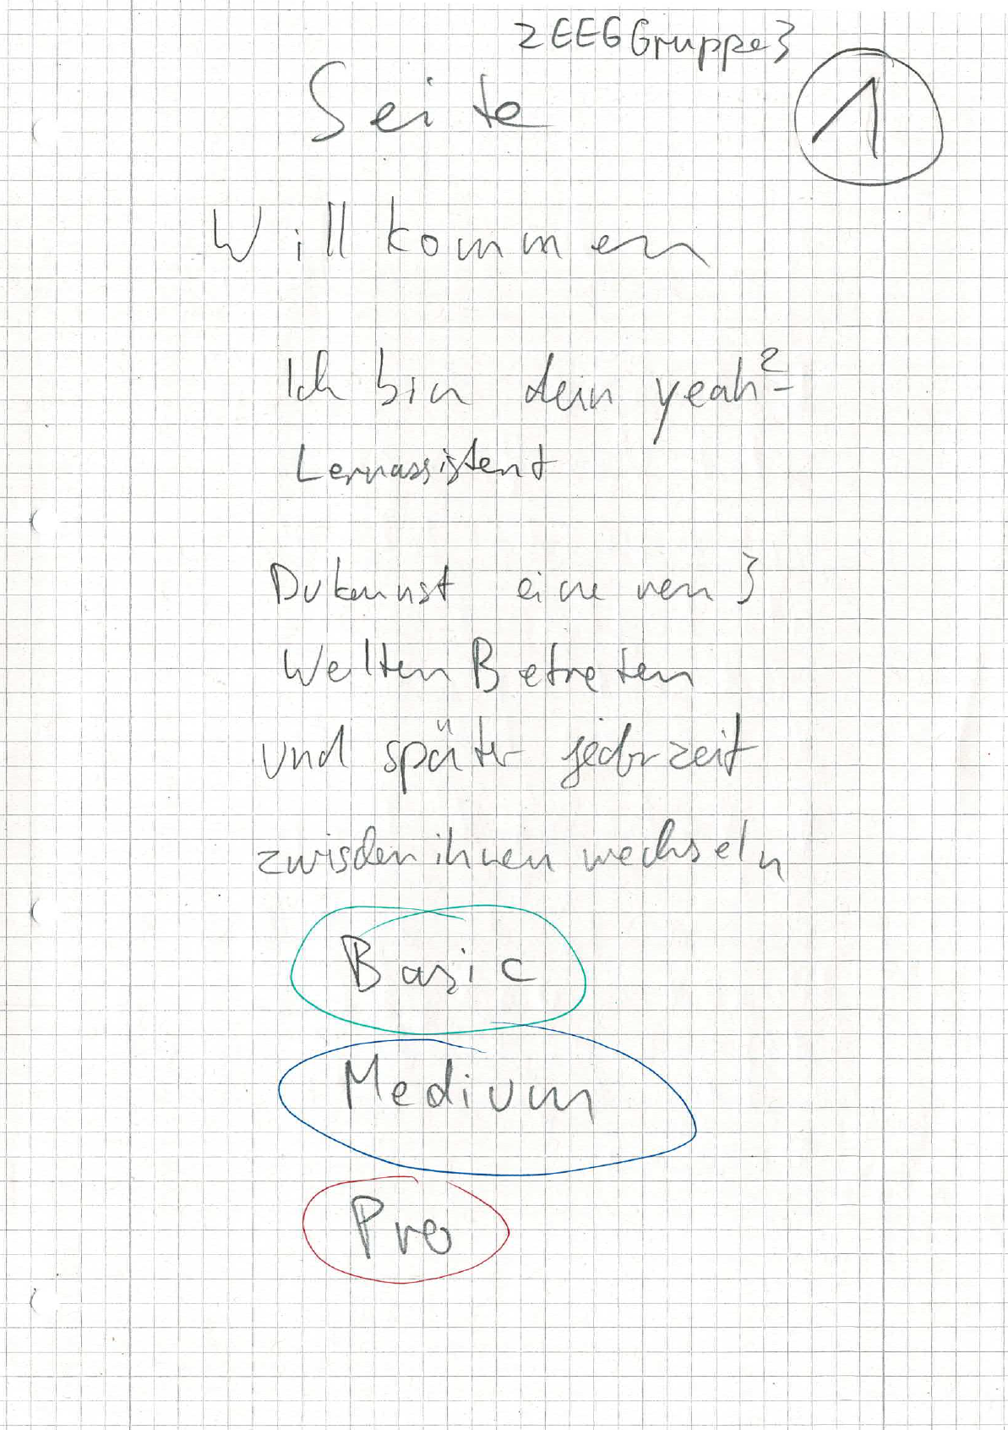
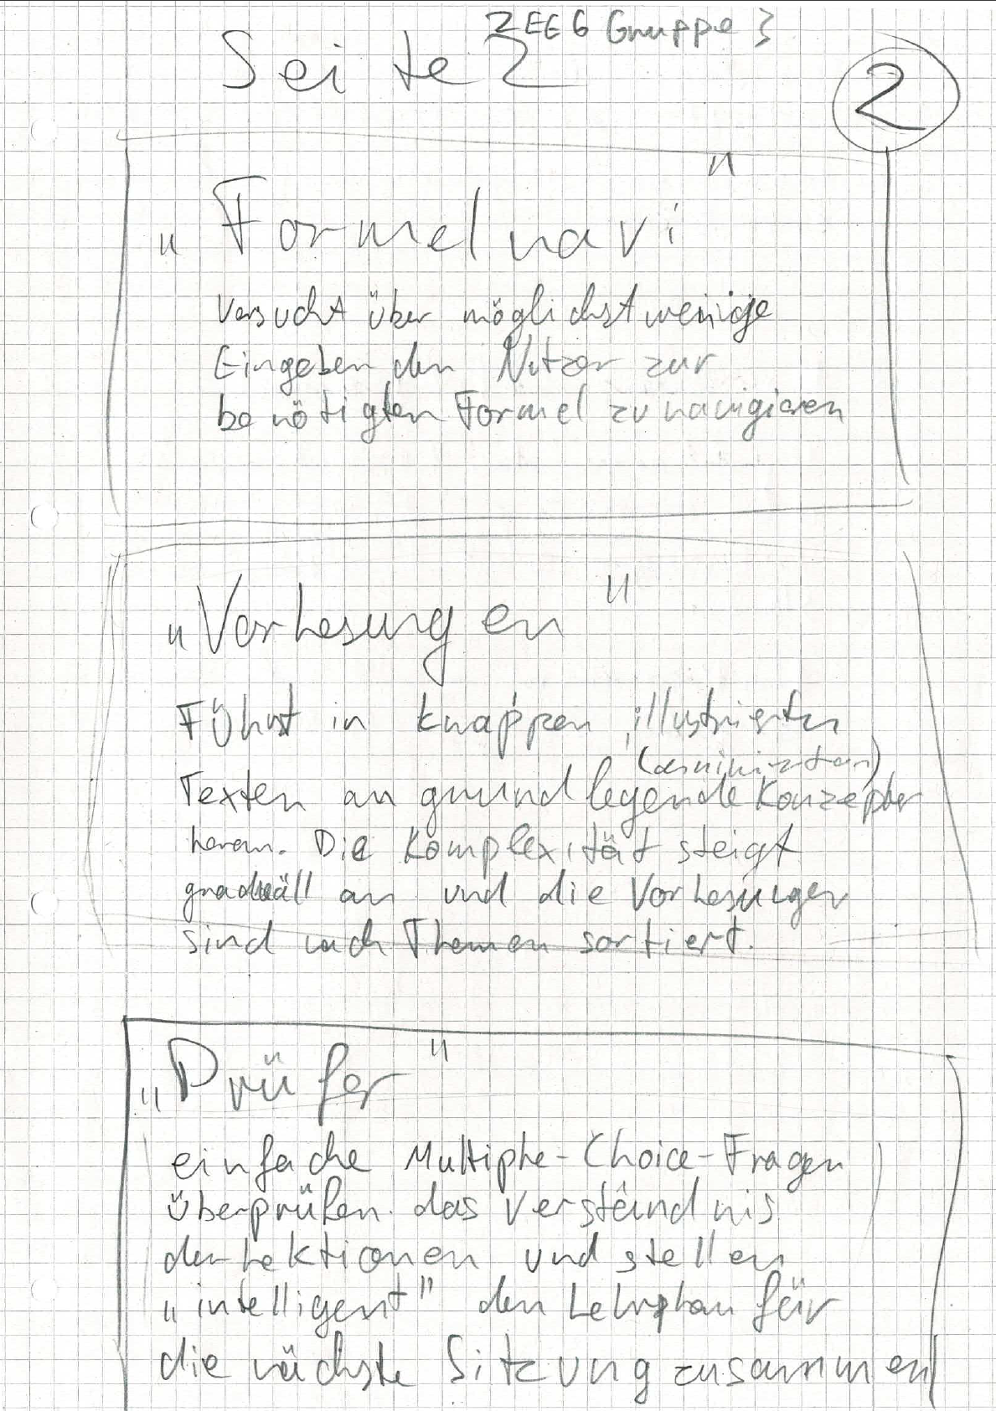
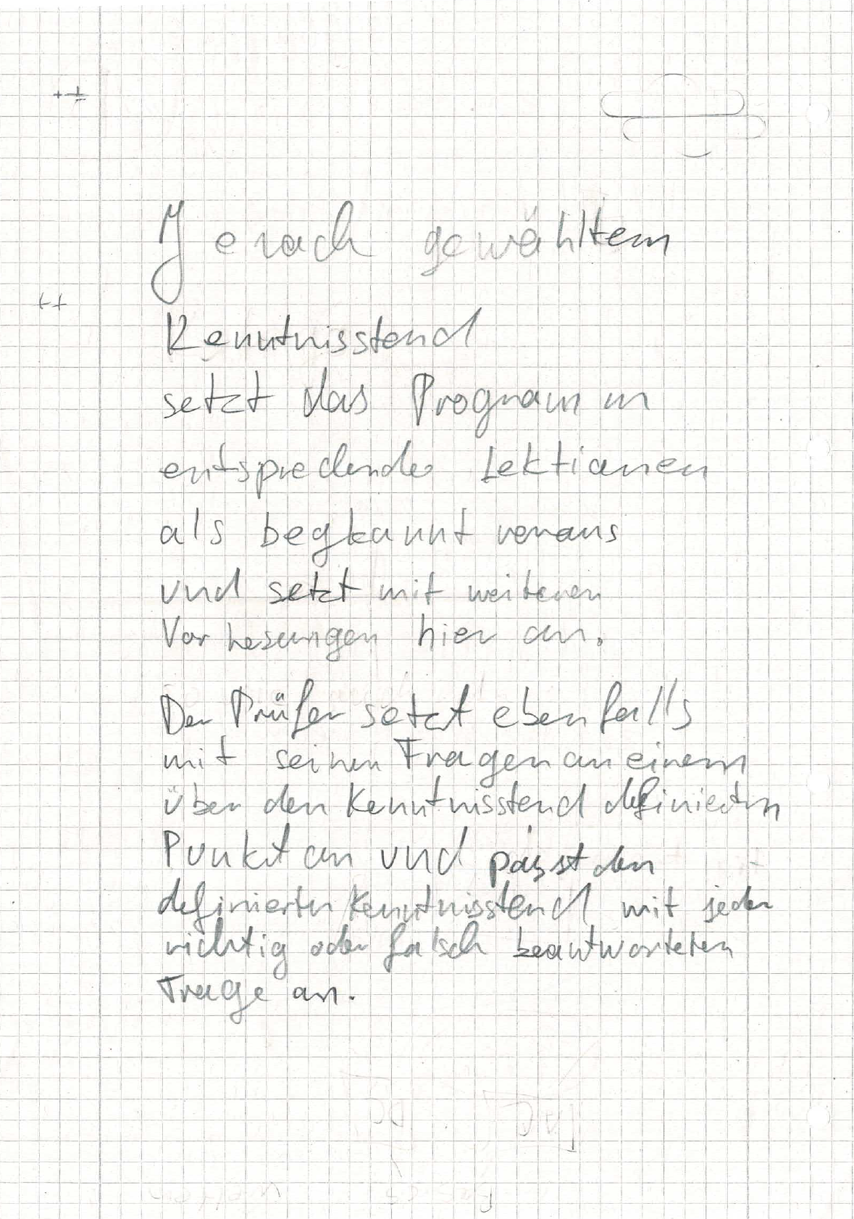
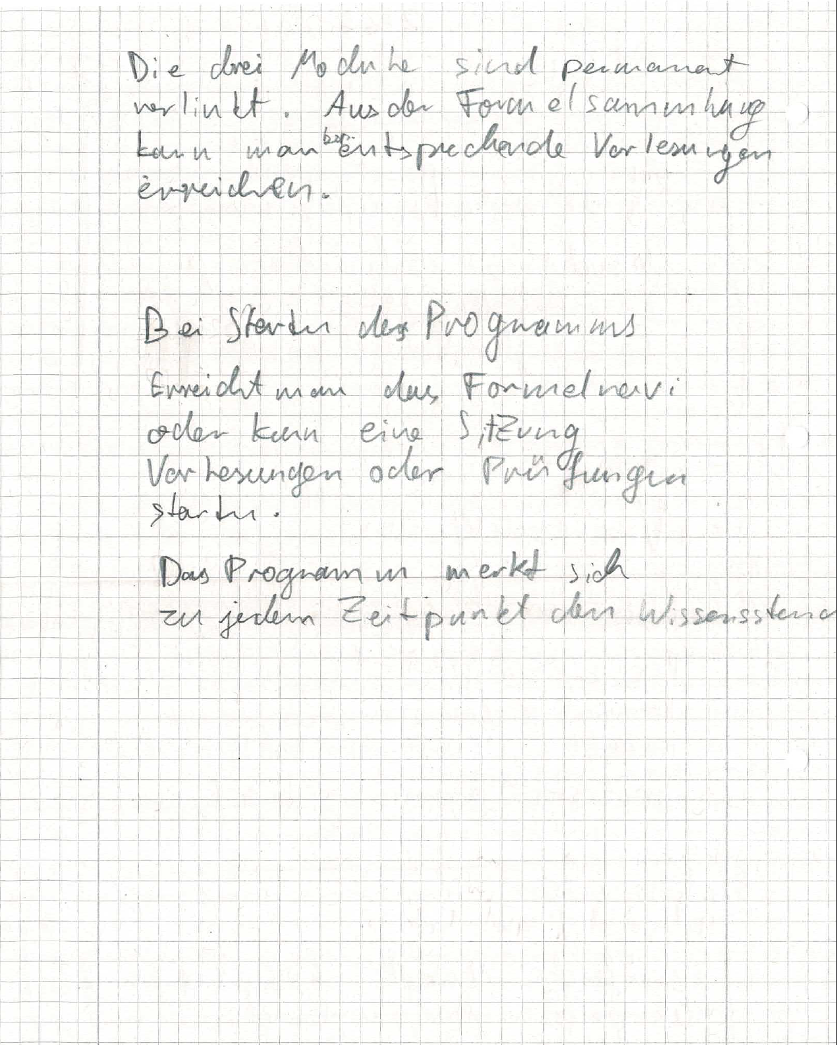
Results of the workshop "Work and education" –
Paper prototype of a learning assistant for electricians

Slide 26

Healthcare in Uelzen
How do you perceive local healthcare?
What is the role of AI in healthcare?
What are key criteria for the acceptance of AI?

Slide 27
Results of the student survey, January 24, 2020
Evaluation of digital measurement and warning systems
Suppose your (grand)parents are already frail due to their age and often can't find their way around. Would you recommend a medical device to them… | do not agree (1) | Rather disagree (2) | Rather agree (3) | Fully agree (4) | no specification | Number of participants (N) | Average value
which informs you or other close persons in case of a fall. | ○ | ○ | ○ | ○ | ○ | 189 | 3,34
which permanently monitors its location and shares it with related persons. | ○ | ○ | ○ | ○ | ○ | 183 | 2,32
which monitors their health status and shares it with their primary doctor. | ○ | ○ | ○ | ○ | ○ | 184 | 3,02

Slide 28
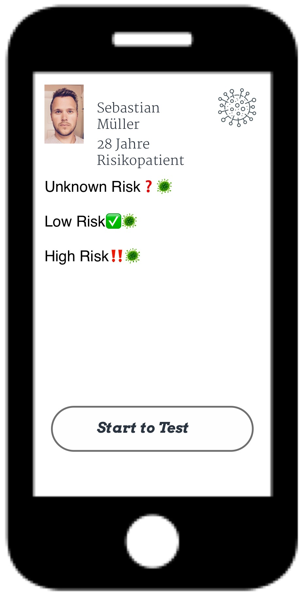
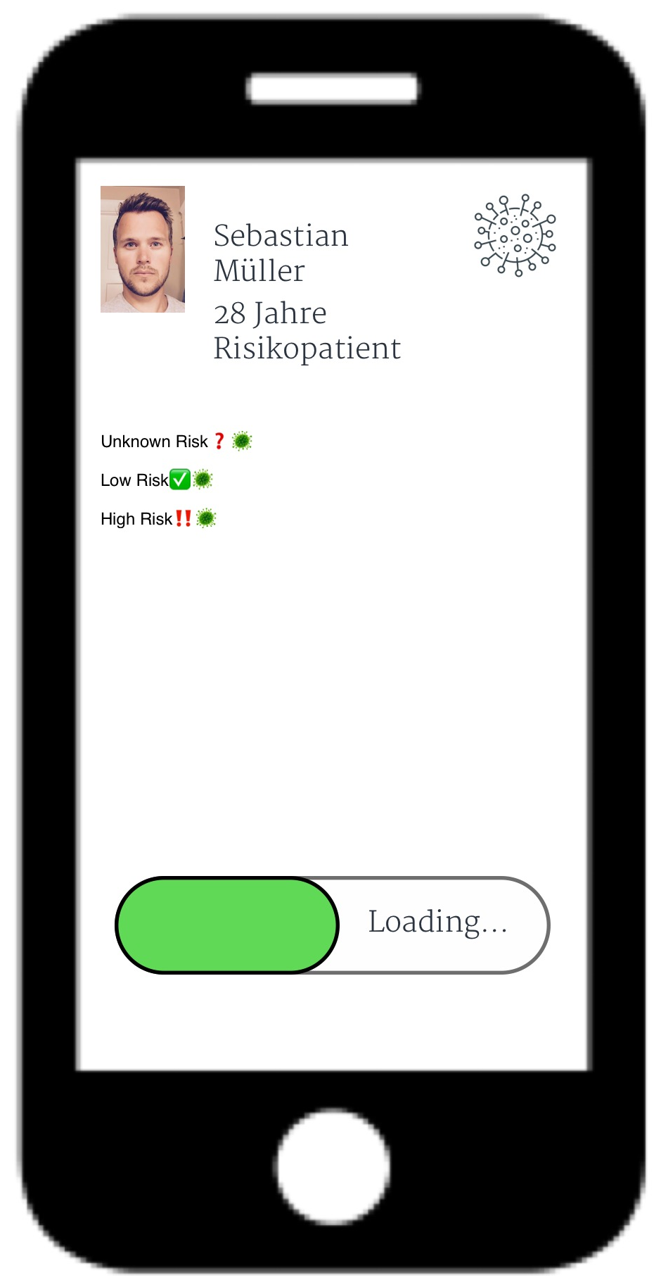
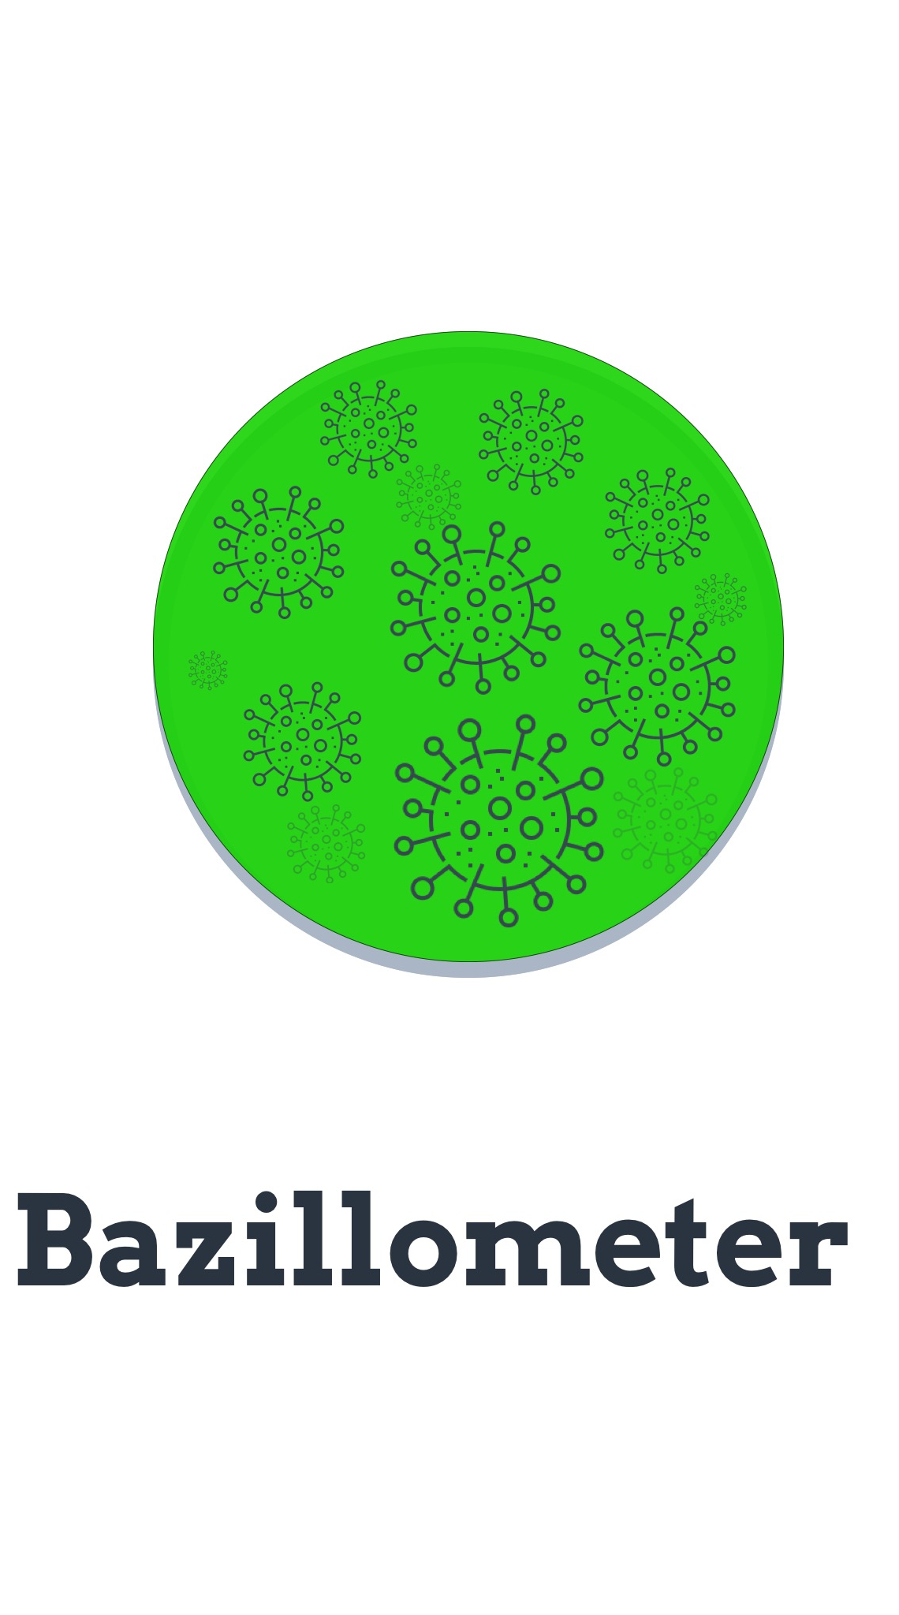
Results of the workshop “Health” -
App "Bazillometer" to protect patients at risk

Slide 29

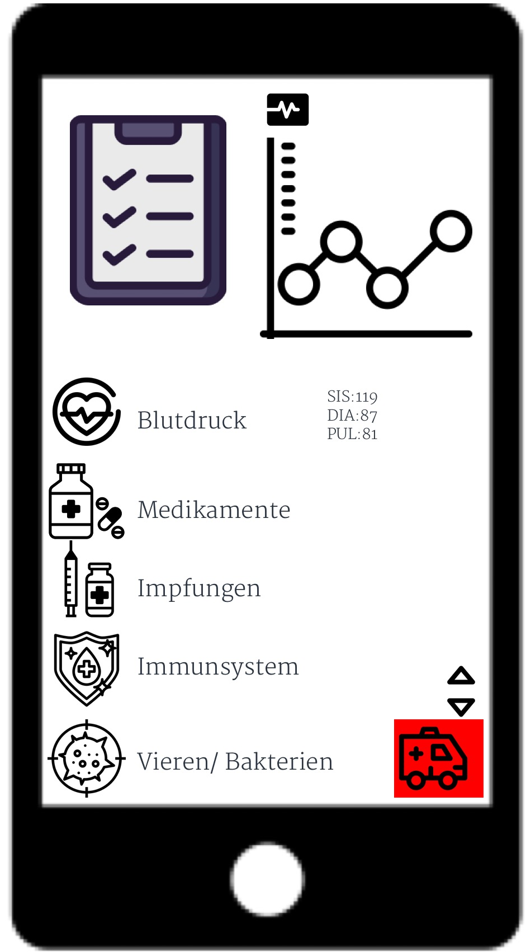
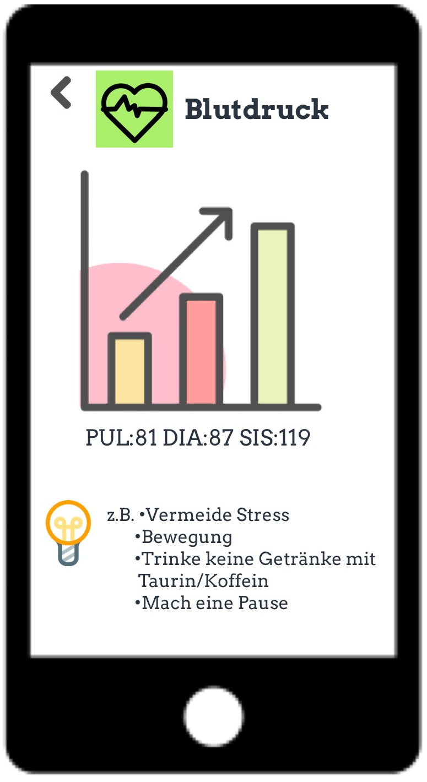
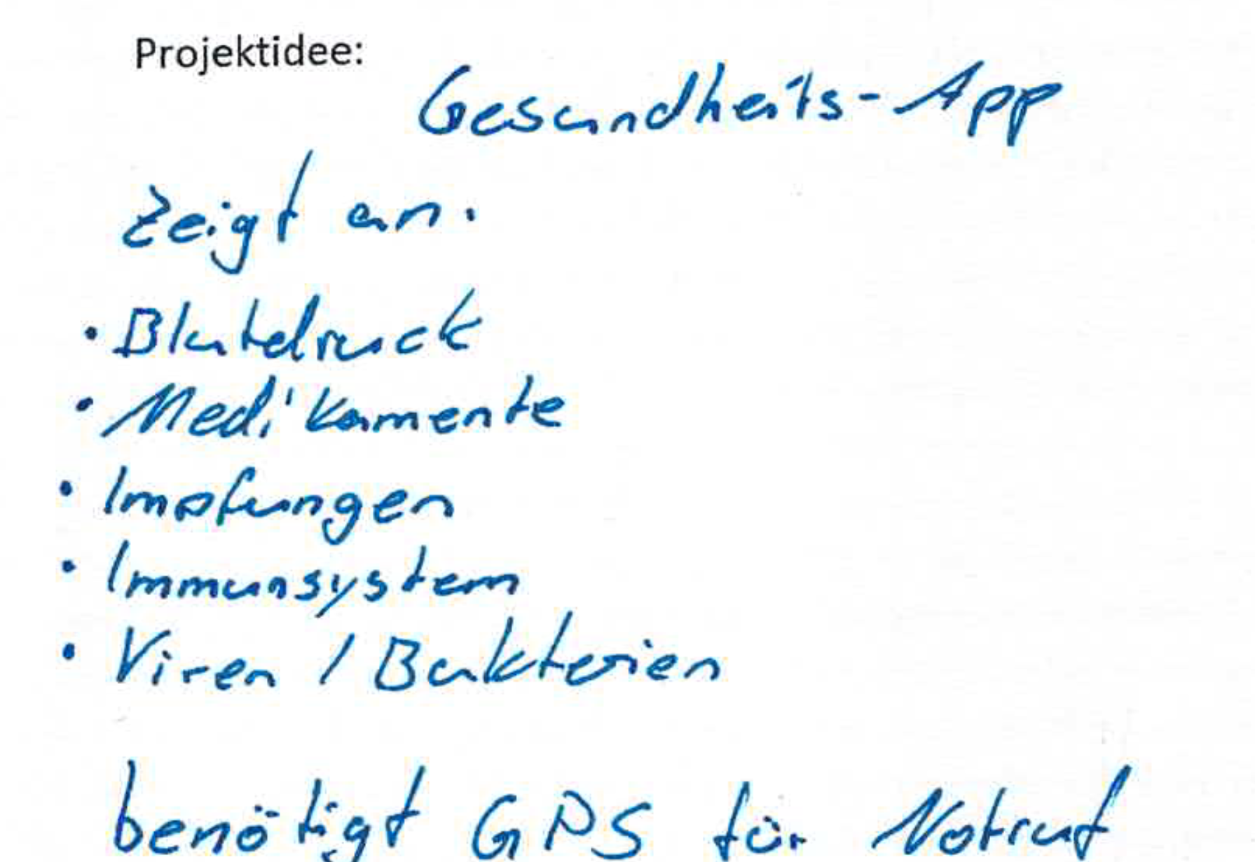
Results of the workshop "Health“ -
App "Dr. Med." for health monitoring

Slide 30

Entertainment offer in the region of Uelzen
How satisfied are you with the entertainment opportunities?
Might virtual events be an alternative?
Are such formats sustainable?
What role does AI play in art?
Notes:
Entertainment offer?!?!?
3. Zeile -> what about?!

Slide 31
Results of the student survey, January 24, 2020
Satisfaction with the entertainment offers
I'm satisfied with the range of offerings within my immediate region in the field of... | Do not agree (1) | Rather disagree (2) | Rather agree (3) | Fully agree (4) | no specification | Number of participants (N) | Average value
Culture (e.g. museums, theaters, exhibitions). | ○ | ○ | ○ | ○ | ○ | 150 | 2,17
Music events (e.g. concerts, festivals). | ○ | ○ | ○ | ○ | ○ | 170 | 2,23
Major sport events (e.g. German Soccer League). | ○ | ○ | ○ | ○ | ○ | 156 | 2,25
Trade shows and conventions (e.g. gaming trade shows). | ○ | ○ | ○ | ○ | ○ | 166 | 1,49
City events and folk festivals (street festivals). | ○ | ○ | ○ | ○ | ○ | 169 | 2,62
Clubs and reunions (shared hobbies). | ○ | ○ | ○ | ○ | ○ | 160 | 2,80
Participation in non-governmental organization or political activism (e.g. environmental protection). | ○ | ○ | ○ | ○ | ○ | 138 | 2,20
Notes:
Überschrift klingt für mich komisch…

Slide 32
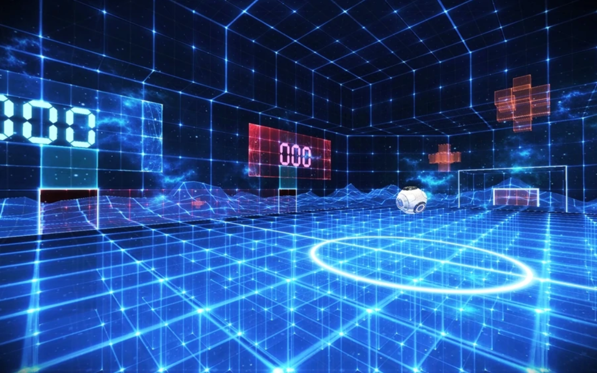
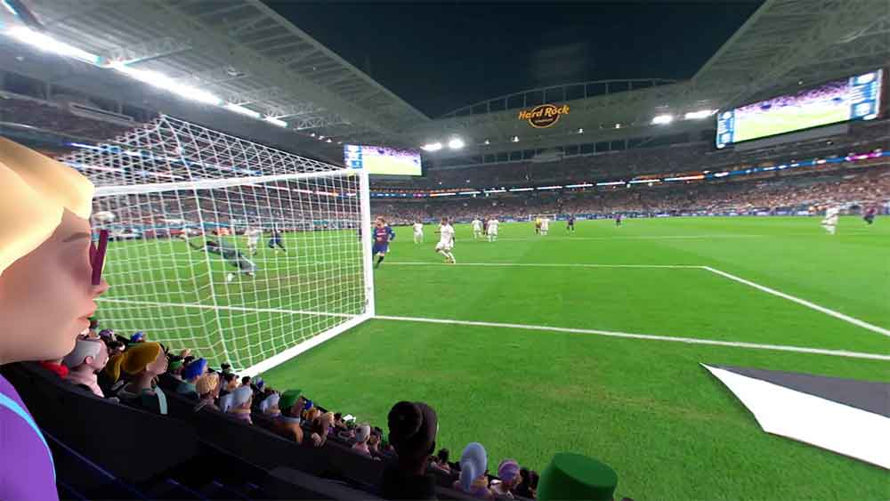
#1 Sample application idea: AI and entertainment
Virtual Arena Uelzen

Slide 33
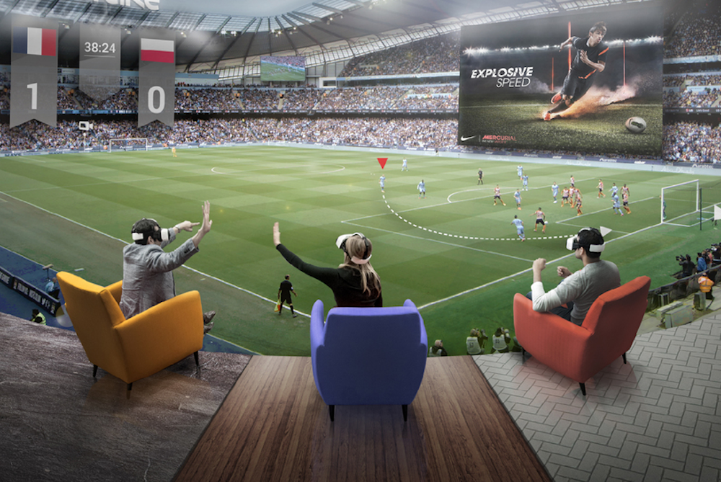
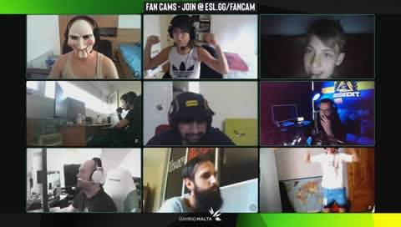
#1 Sample application idea: AI and entertainment
Virtual Arena in the new BBS building - Event space in VR
Place where events can be attended together in VR
"Virtual public viewing" of sporting events, concerts, trade fairs, ...
  Additional sensory impressions like vibration of the floor (4D cinema)
  Interaction with live audience via chat, "fan cam“ or holograms
What will make the arena better than the home screen experience?
  Stronger sense of community?
  More realistic sensory impressions?
  Flexibility due to different perspectives?
What could be the problems of such a VR arena? What are possible solutions?
  Lack of atmosphere of a live event
  Occupancy at peak times? (Voting system)

Slide 34
Thank you very much for your attention!
If you have any further questions, please feel free to contact us via email:
Matthias Ruhland: m.ruhland@izt.de
Michael Scharp: m.scharp@izt.de
Or visit us at: www.izt.de

