Slide 1
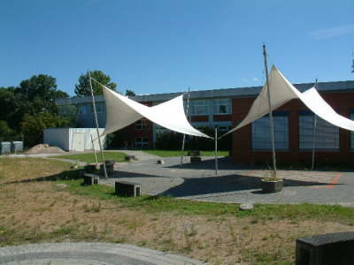
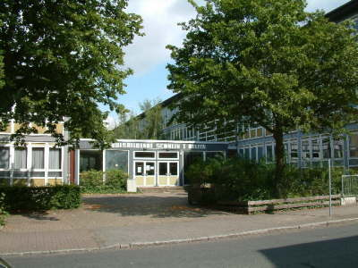
Berufsbildende Schulen I Uelzen
Wir leben Nachhaltigkeit!
Projekt der Klasse 2-FOW-A
Copyright 2018 BBS I Uelzen – Stefan Nowatschin
Copyright 2018 BBS I Uelzen – Stefan Nowatschin

Slide 2
Berufsbildende Schulen I Uelzen
Wir leben Nachhaltigkeit!
Lunchliebe
Heiße Suppe für kühle Köpfe
Copyright 2018 BBS I Uelzen – Stefan Nowatschin
Copyright 2018 BBS I Uelzen – Stefan Nowatschin

Slide 3
Im Februar 2020 wurde ein zweisprachiger BBS I Uelzen Informationsfilm produziert: www.bbs1-uelzen.de und https://www.youtube.com/watch?v=jf19H_UgFmo (vom Kooperations- und Finanzpartner Ostfalia – Prof. Dr. Launer dort eingestellt).

Slide 4
Heiße Suppen für kühle Köpfe
Project – BBSI – Business & Economics – Mr.Nierath
By: Joolie, Nele, Vivien & Stefanie

Slide 5
Setup
Lunchliebe - what’s that?
Where can i get Lunchliebe?
Data & Research
The 4 P´s
Marketing – close up
Spot
Pro & Cons
Résumé

Slide 6
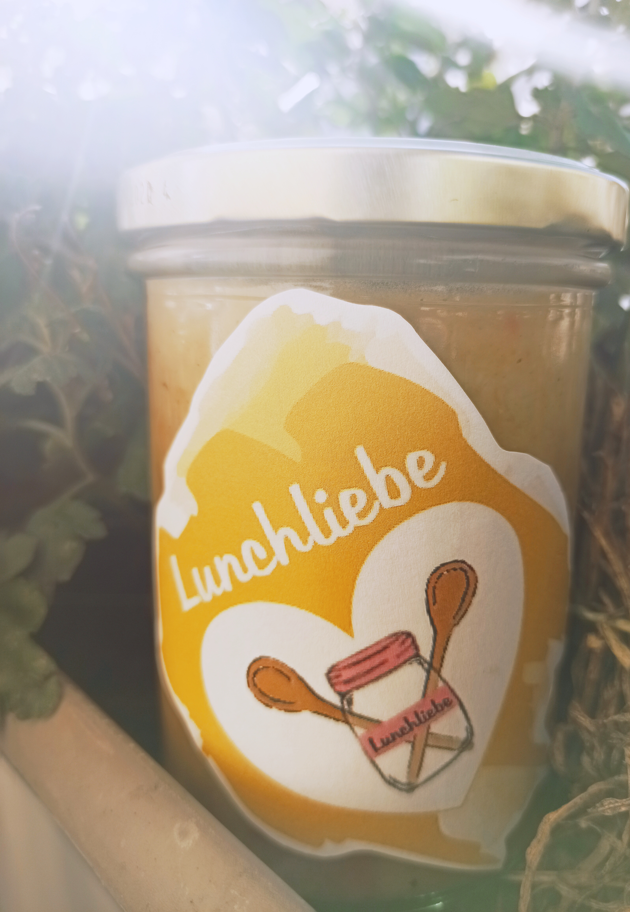
Just a Soup?
Traditionell recipes
Without any chemical additives
Prevents food waste
Pledge system avoids plastic waste
Powered by solar energy
Vegan

Slide 7
Bring your own spoon.

Slide 8
55,50%
48,50%
57,40%
Age
Healty nutrition
Gender
Potential customers
Strongly interested

Slide 9
The 4 P´s
Product
Good for you!
Good for the environment
Eco & fair
Price
Start with low price strategy
Price = 3€ plus 1 € pledge
Introductory price catches interest
Place
Sold via vending machines
Later cooperation with local supermarkets
Promotion
Posters & Flyers
Instagram
Cooperation with Youtube influencer
Clip

Slide 10
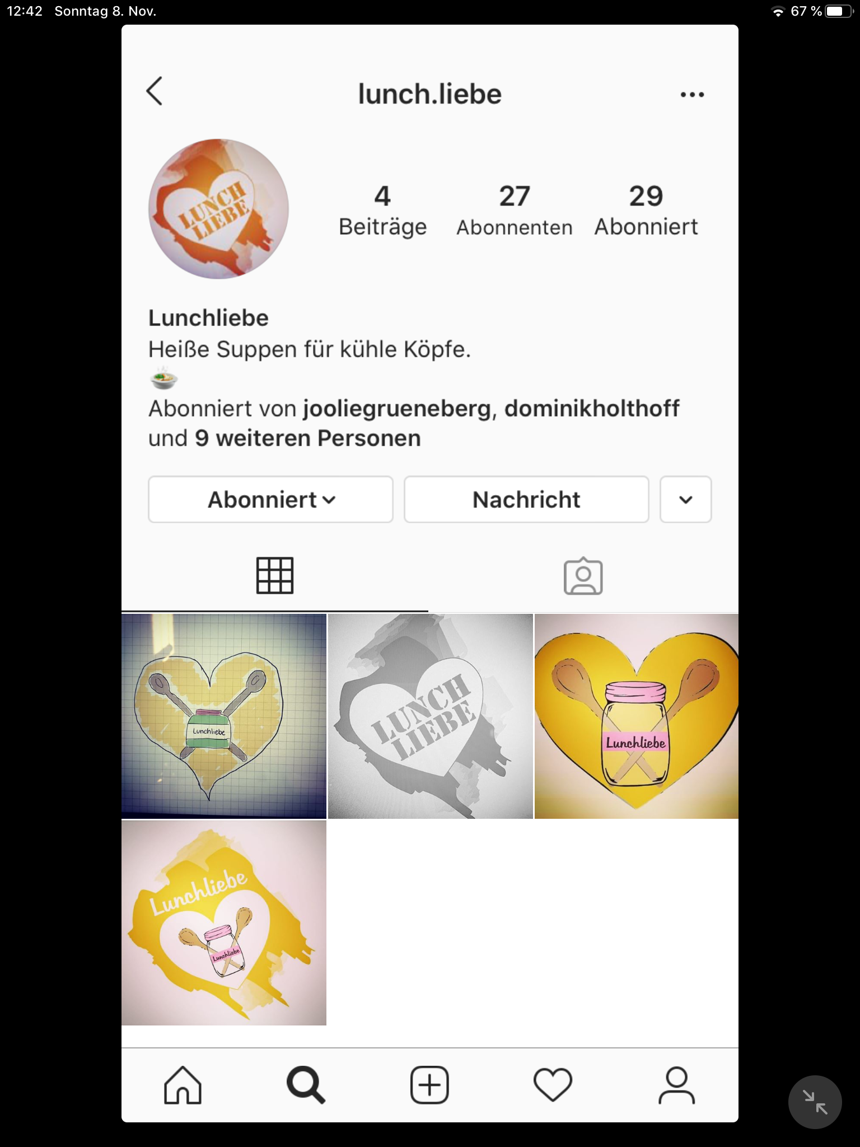
Marketing

Slide 11
Advertising clip

Slide 12
Pro & Cons
Pro
Affordable hearty meal
Always available
Organic & healthy
Cons
Meatlovers will not be satisfied
Just available in the north of Germany
Pledge depends on the returning in schools

Slide 13
Less food waste
Organic & fair produced
Always available
Less plastic & single use packaging
Animal friendly because plant based
Sustainable & keeps students healthy

Slide 14
Thanks!
Any questions?
You can find us at:
lunch.liebe

Slide 15
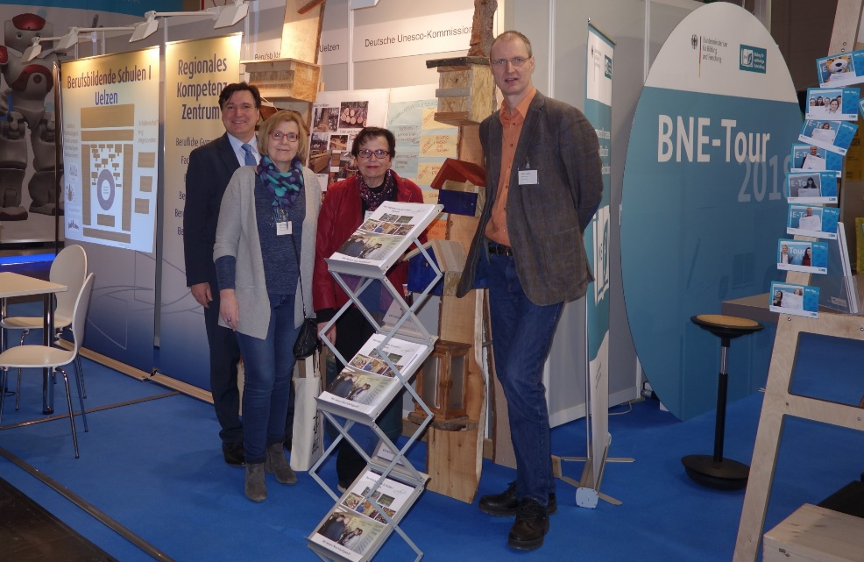
Copyright 2018 BBS I Uelzen – Stefan Nowatschin – All rights reserved.

